Slide 1
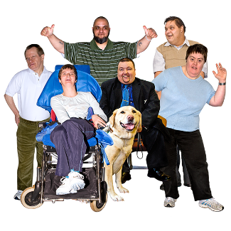
Filling in the Gaps:
the role of self-advocacy groups in supporting the health and wellbeing of people with learning disabilities during the pandemic
By Lorna Rouse, Liz Tilley, Jan Walmsley and Shaun Picken
Funded by The Open University
Illustrations by Inspired Pics and Photosymbols

Slide 2
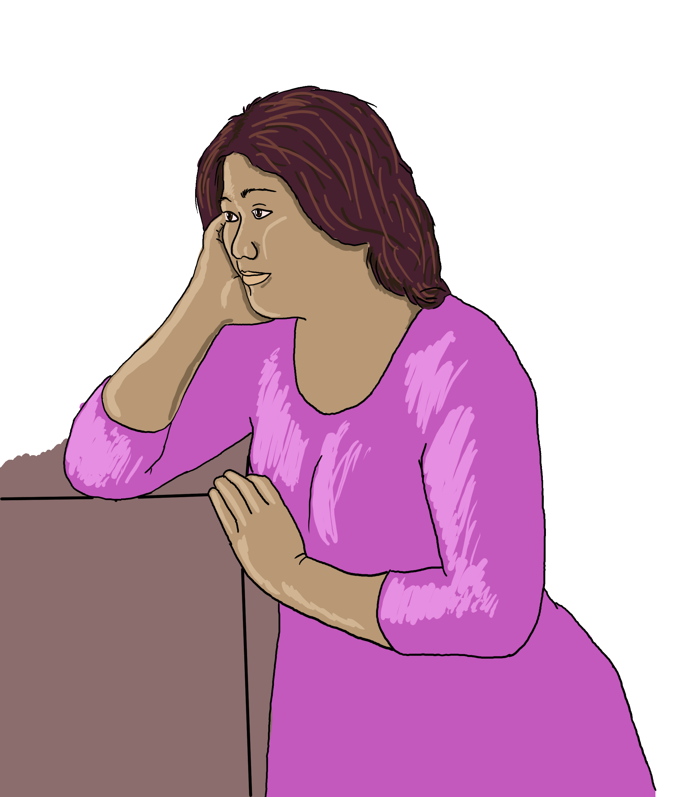
The background
COVID-19 has made life hard for a lot of people with learning disabilities
We heard about self-advocacy groups doing some extraordinary things to help people
We decided to do some research to find out more

Slide 3
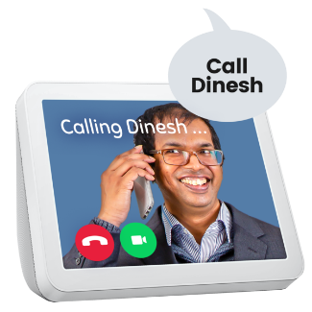
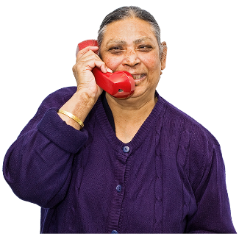
What we did
We spoke to 11 self-advocacy groups in England.
We interviewed:
22 self-advocates
14 self-advocacy support workers
2 family members
Because of COVID-19, these interviews were done remotely, either online or by phone

Slide 4
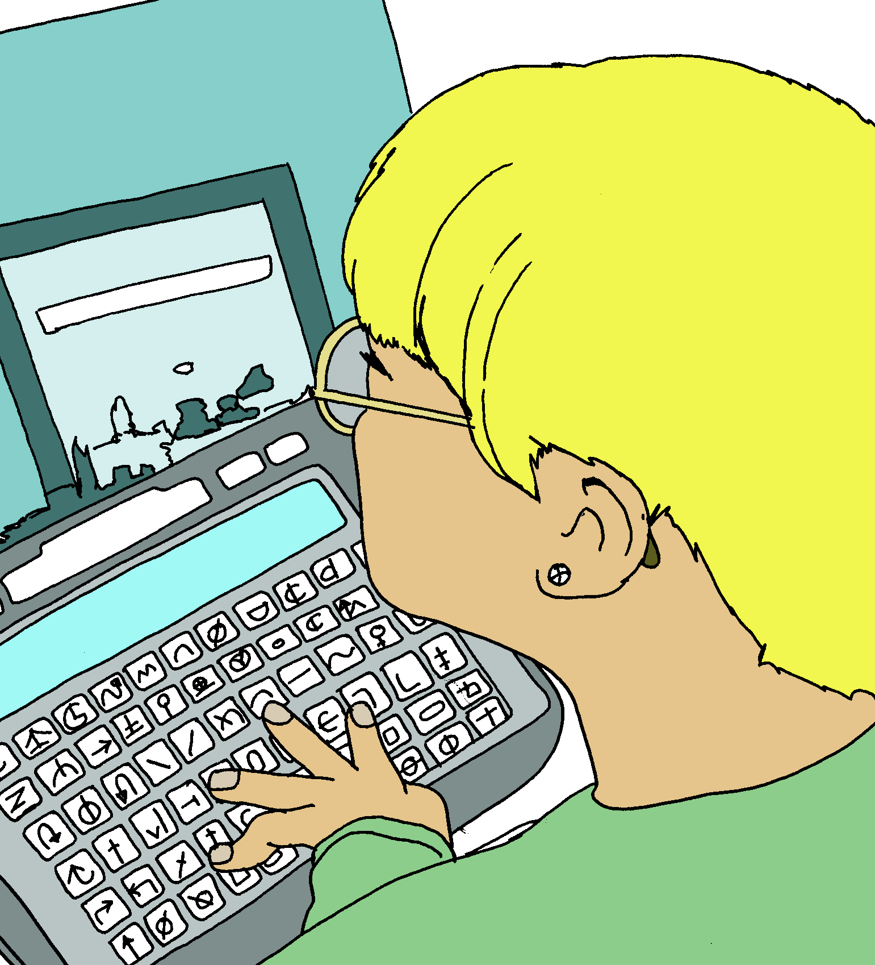
Getting people online
Self-advocacy groups got a lot of members online really early on in the pandemic
They helped people to get equipment and wifi, and taught them how to use the technology
This helped lots of people to stay connected during the pandemic.
This filled in a gap: other services did not always manage to get people online this fast in Lockdown 1.

Slide 5
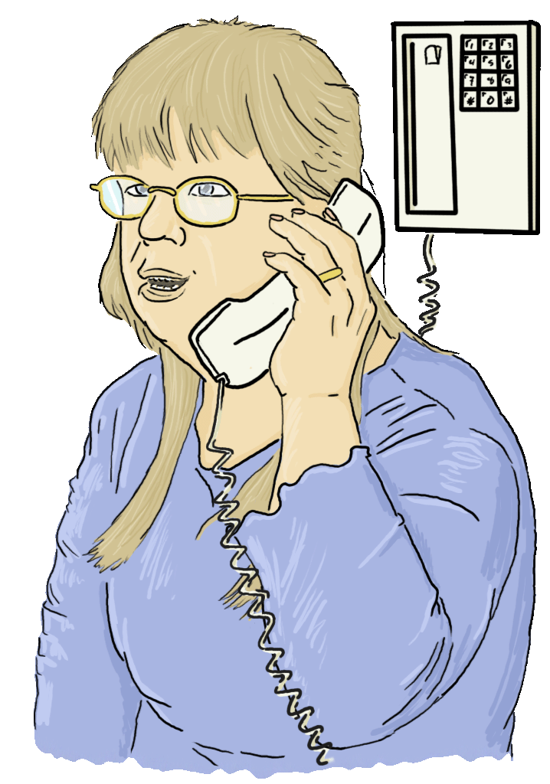
Offline help
But not everyone could get online
So many self-advocacy groups set up phone rotas
They phoned their members regularly
Some people with learning disabilities said this was the only contact they had during lockdown

Slide 6
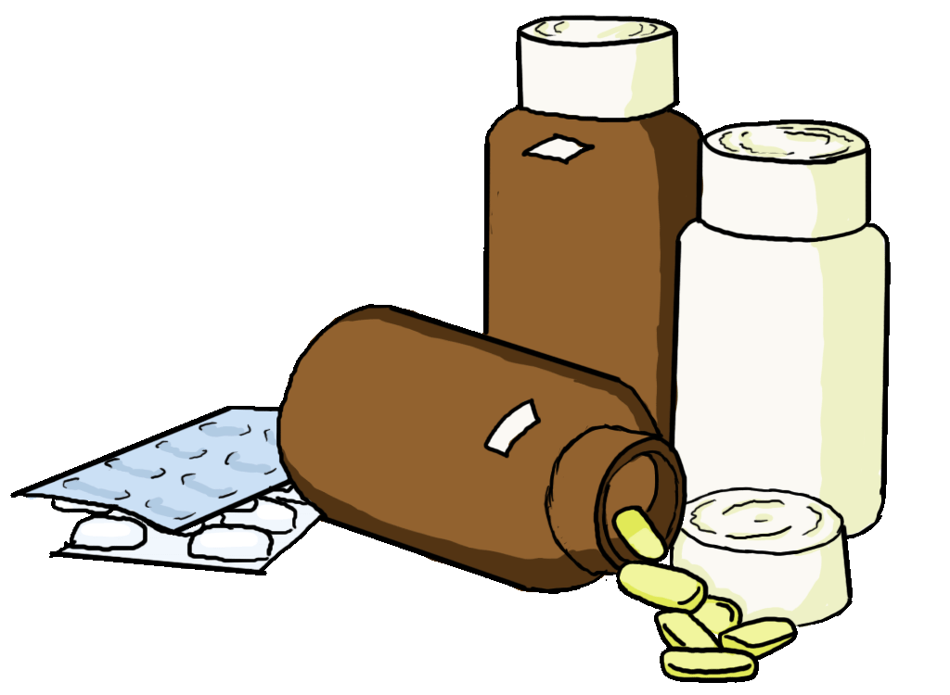
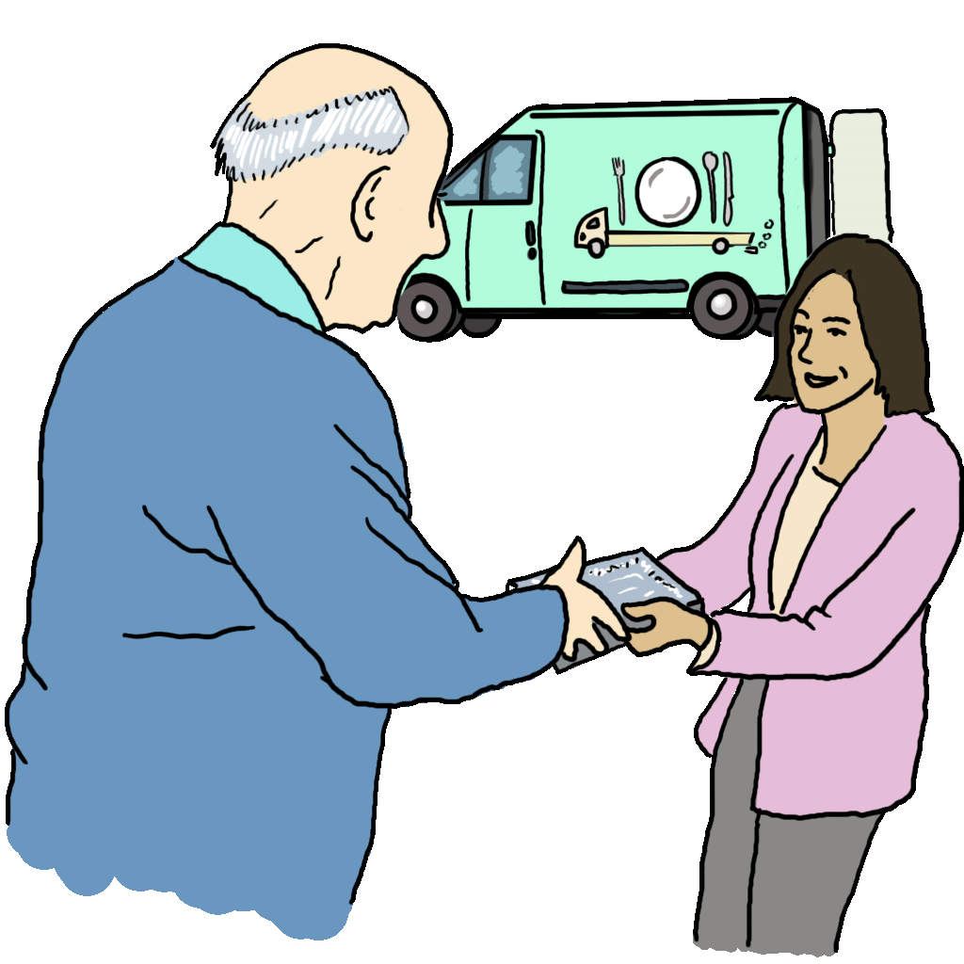
Practical support
Self-advocacy groups played a vital role with:
Sorting out and delivering medication
Helping people do food shopping
Delivering food packages

Slide 7
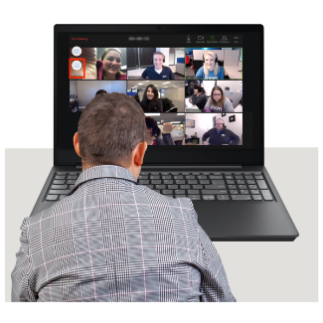
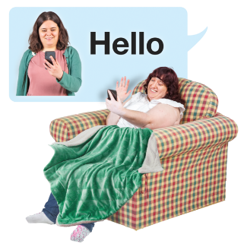
Supporting people’s mental health and wellbeing
Self-advocacy groups did lots of things to help people’s wellbeing, for example:
Organising fun events and activities on zoom
Sending out activities and information in the post
Keeping in contact with people and reducing loneliness
Putting people in touch with services if they faced a mental health crisis

Slide 8
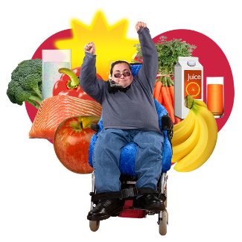
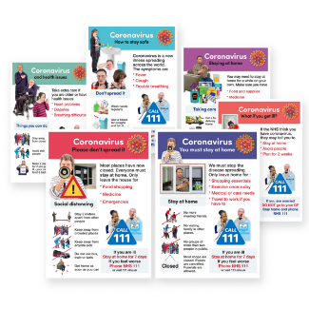
Supporting people’s physical health
These are some things the groups did to help people’s physical health:
Helped people to eat well, through online cooking sessions
Helped people to keep fit through online fitness classes
Helped people to get their medication
Helped people to access health services during lockdown
Sent out Easy Read information about coronavirus

Slide 9
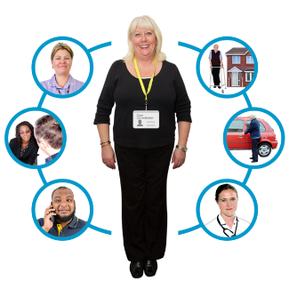
Signposting
All self-advocacy groups spent a lot of time helping members to get the help and support they needed.
Self-advocacy groups managed lots of referrals to GPs, social services and food banks.
They also helped people to sort out benefits issues during the pandemic.

Slide 10
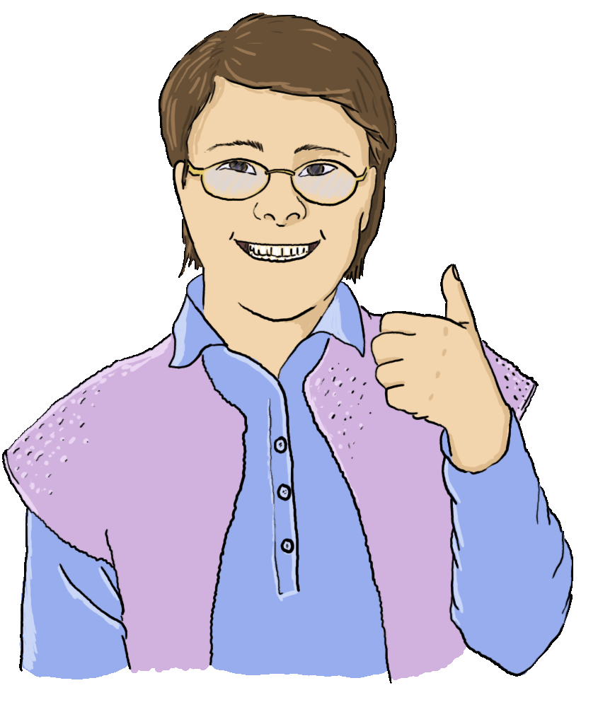
Going above and beyond
…my group is always
there, been there to pick me up, even through
Lockdown... they’ve been really good…I think they’ve overworked themselves to help other people.

Slide 11
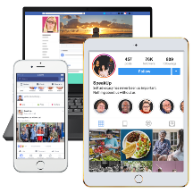
What support have people with learning disabilities received to enable them to use technology to keep connected and stay well during the pandemic?
Professor Jane Seale
http://www.open.ac.uk/health-and-social-care/research/shld/node/371
Image: https://www.learningdisabilityengland.org.uk/what-we-do/keeping-informed-and-in-touch-during-coronavirus/

Slide 12
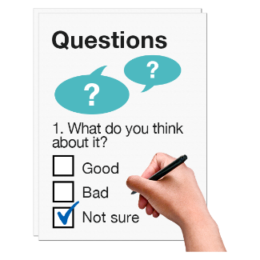
Methods
Online survey disseminated via social media and email lists
106 respondents
Interviews with 44 supporters and 20 people with learning disabilities

Slide 13
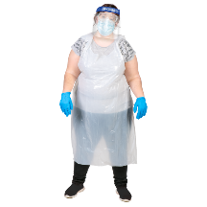
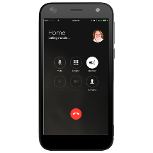
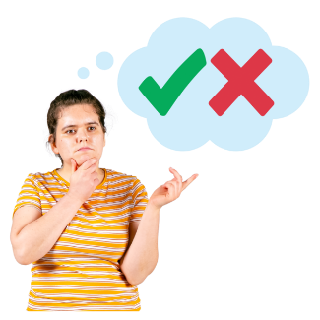
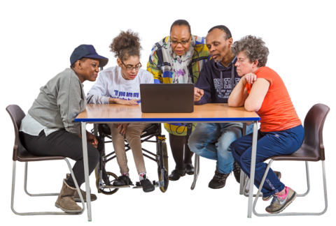
Findings | Findings
 | 1. Supporters were using a mix of technology and other methods.
 | This was because not all people with learning disabilities wanted to or had access to technology.
 | 2. Supporters were using lots of different types of technology to help people with learning disabilities to say connected- especially mobile phones and Zoom
 | 3. Supporters who did use technology to help people with learning disabilities to stay connected before the covid-19 pandemic had to learn new things and see what did or did not work.
 | 4. The supporters said it was really important for people who lived with a person with a learning disability, like a carer or a parent, to help them to use technology.

Slide 14
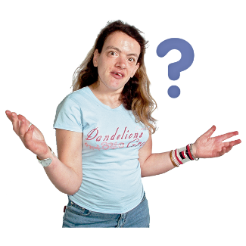
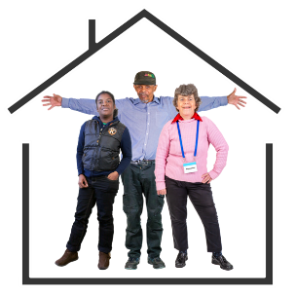
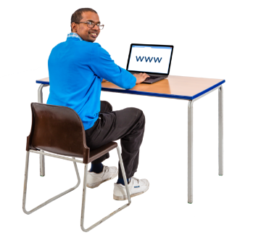
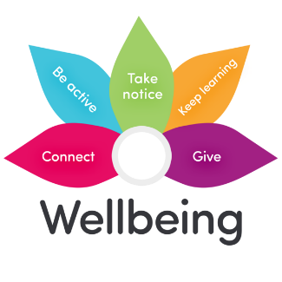
Findings | Findings
 | 5. Some supporters shared stories of people with learning disabilities who did not have access to technology.
 | 6. Some shared stories of people with learning disabilities not knowing how to use the technology.
 | 7. Some supporters said that people with learning disabilities did not have the right support in their homes to use technology.
 | 8. There were good stories of people with learning disabilities who were able to use technology during the Pandemic.
 | They said it helped with their mental health and wellbeing. It also helped them to connect with family and friends.

Slide 15
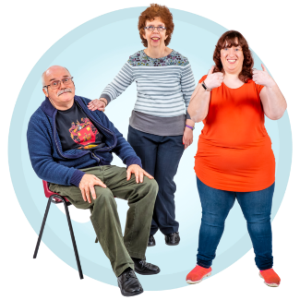
Findings | Findings
 | 9. The use of technology during the Coronavirus Pandemic has shown the amazing things that people with learning disabilities can do, with the right support.

Slide 16
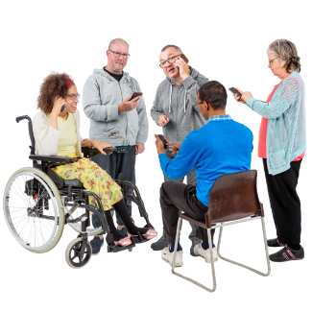
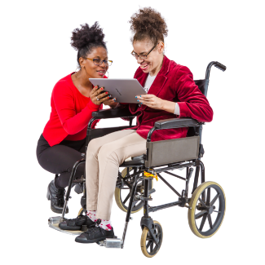
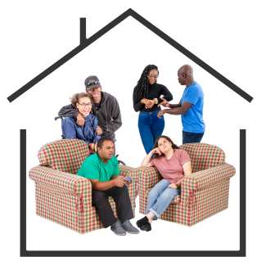
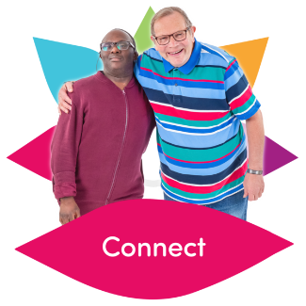
Conclusion | Findings
 | This work has shown how important it is for people with learning disabilities to have access to technology.
 | It is really important that they have the right support to help them to use it.
 | This support needs to come from people they live with as well as other places such as Self-Advocacy groups and Day Services.
 | All those who provide support to people with learning disabilities need to know how to use the technology and make sure that they have access to it so they can keep connected and stay well.

Slide 17
Get in touch:
Liz Tilley elizabeth.tilley@open.ac.uk
Jane Seale jane.seale@open.ac.uk

