Slide 1
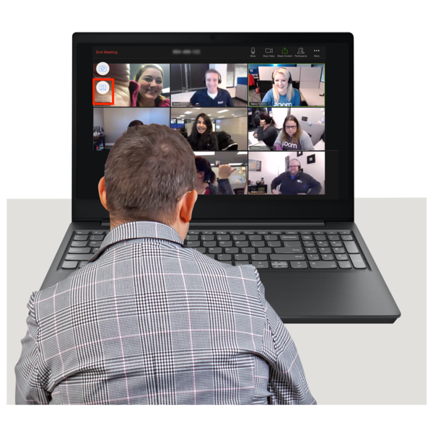
Great things to do online during covid
Zoom
Page 1
You Tube
Page 2
Facebook Apps
Page 3
On Line
Page 4 and 5

Slide 2
1. Ryedale Mencap
Sessions all week from zumba, discos and social clubs. via their own zoom.
https://www.facebook.com/ryedaleanddistrictmencap/
2. Electric Umbrella
Sessions include a singalong, Saturday breakfast club, open Mic and a Monday evening music show
www.electricumbrella.co.uk
3. Learning Disability England
Free webinars
https://www.learningdisabilityengland.org.uk/
4. People First
Sessions, such as exercise and mindfulness
https://www.peoplefirstinfo.org.uk/events/

Slide 3
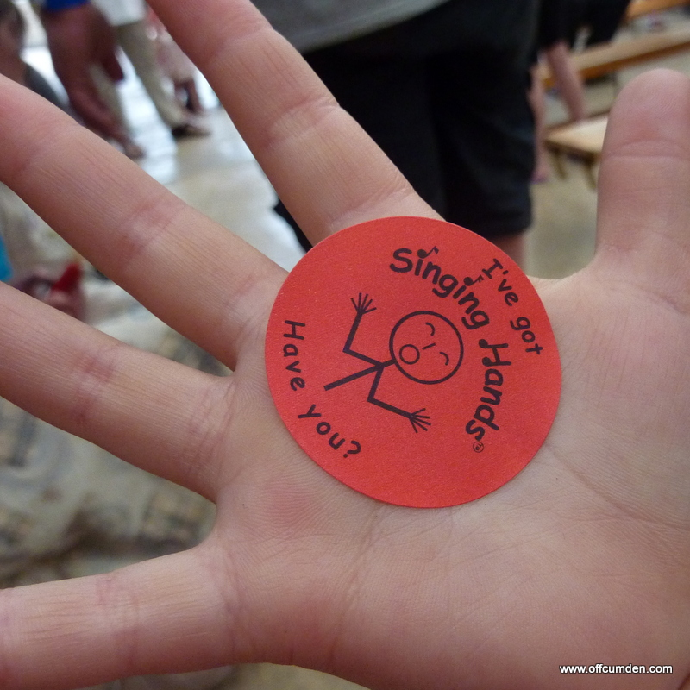
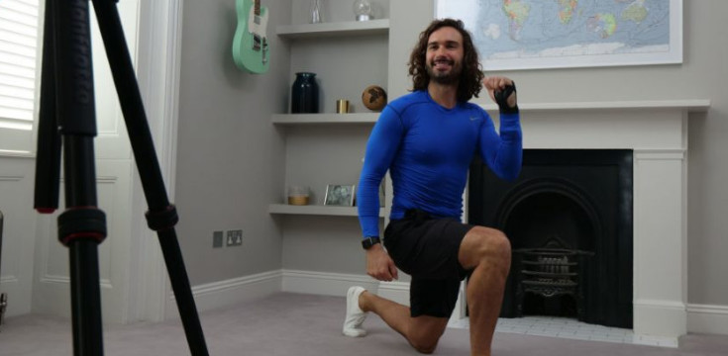
You Tube
1. Mencap TV
Videos to keep you busy over lockdown
https://www.youtube.com/channel/UCSioctelJtiJvtZkCOxrJ6g/featured
2. Singing Hands
Makaton sing and sign videos
https://www.youtube.com/user/SingingHandsUK
3. Heart and Soul
Creative sessions including poetry and craft
https://www.youtube.com/user/heartandsoulart
4. Joe Wicks
Every day. Keep Fit.
https://www.youtube.com/channel/UCAxW1XT0iEJo0TYlRfn6rYQ

Slide 4
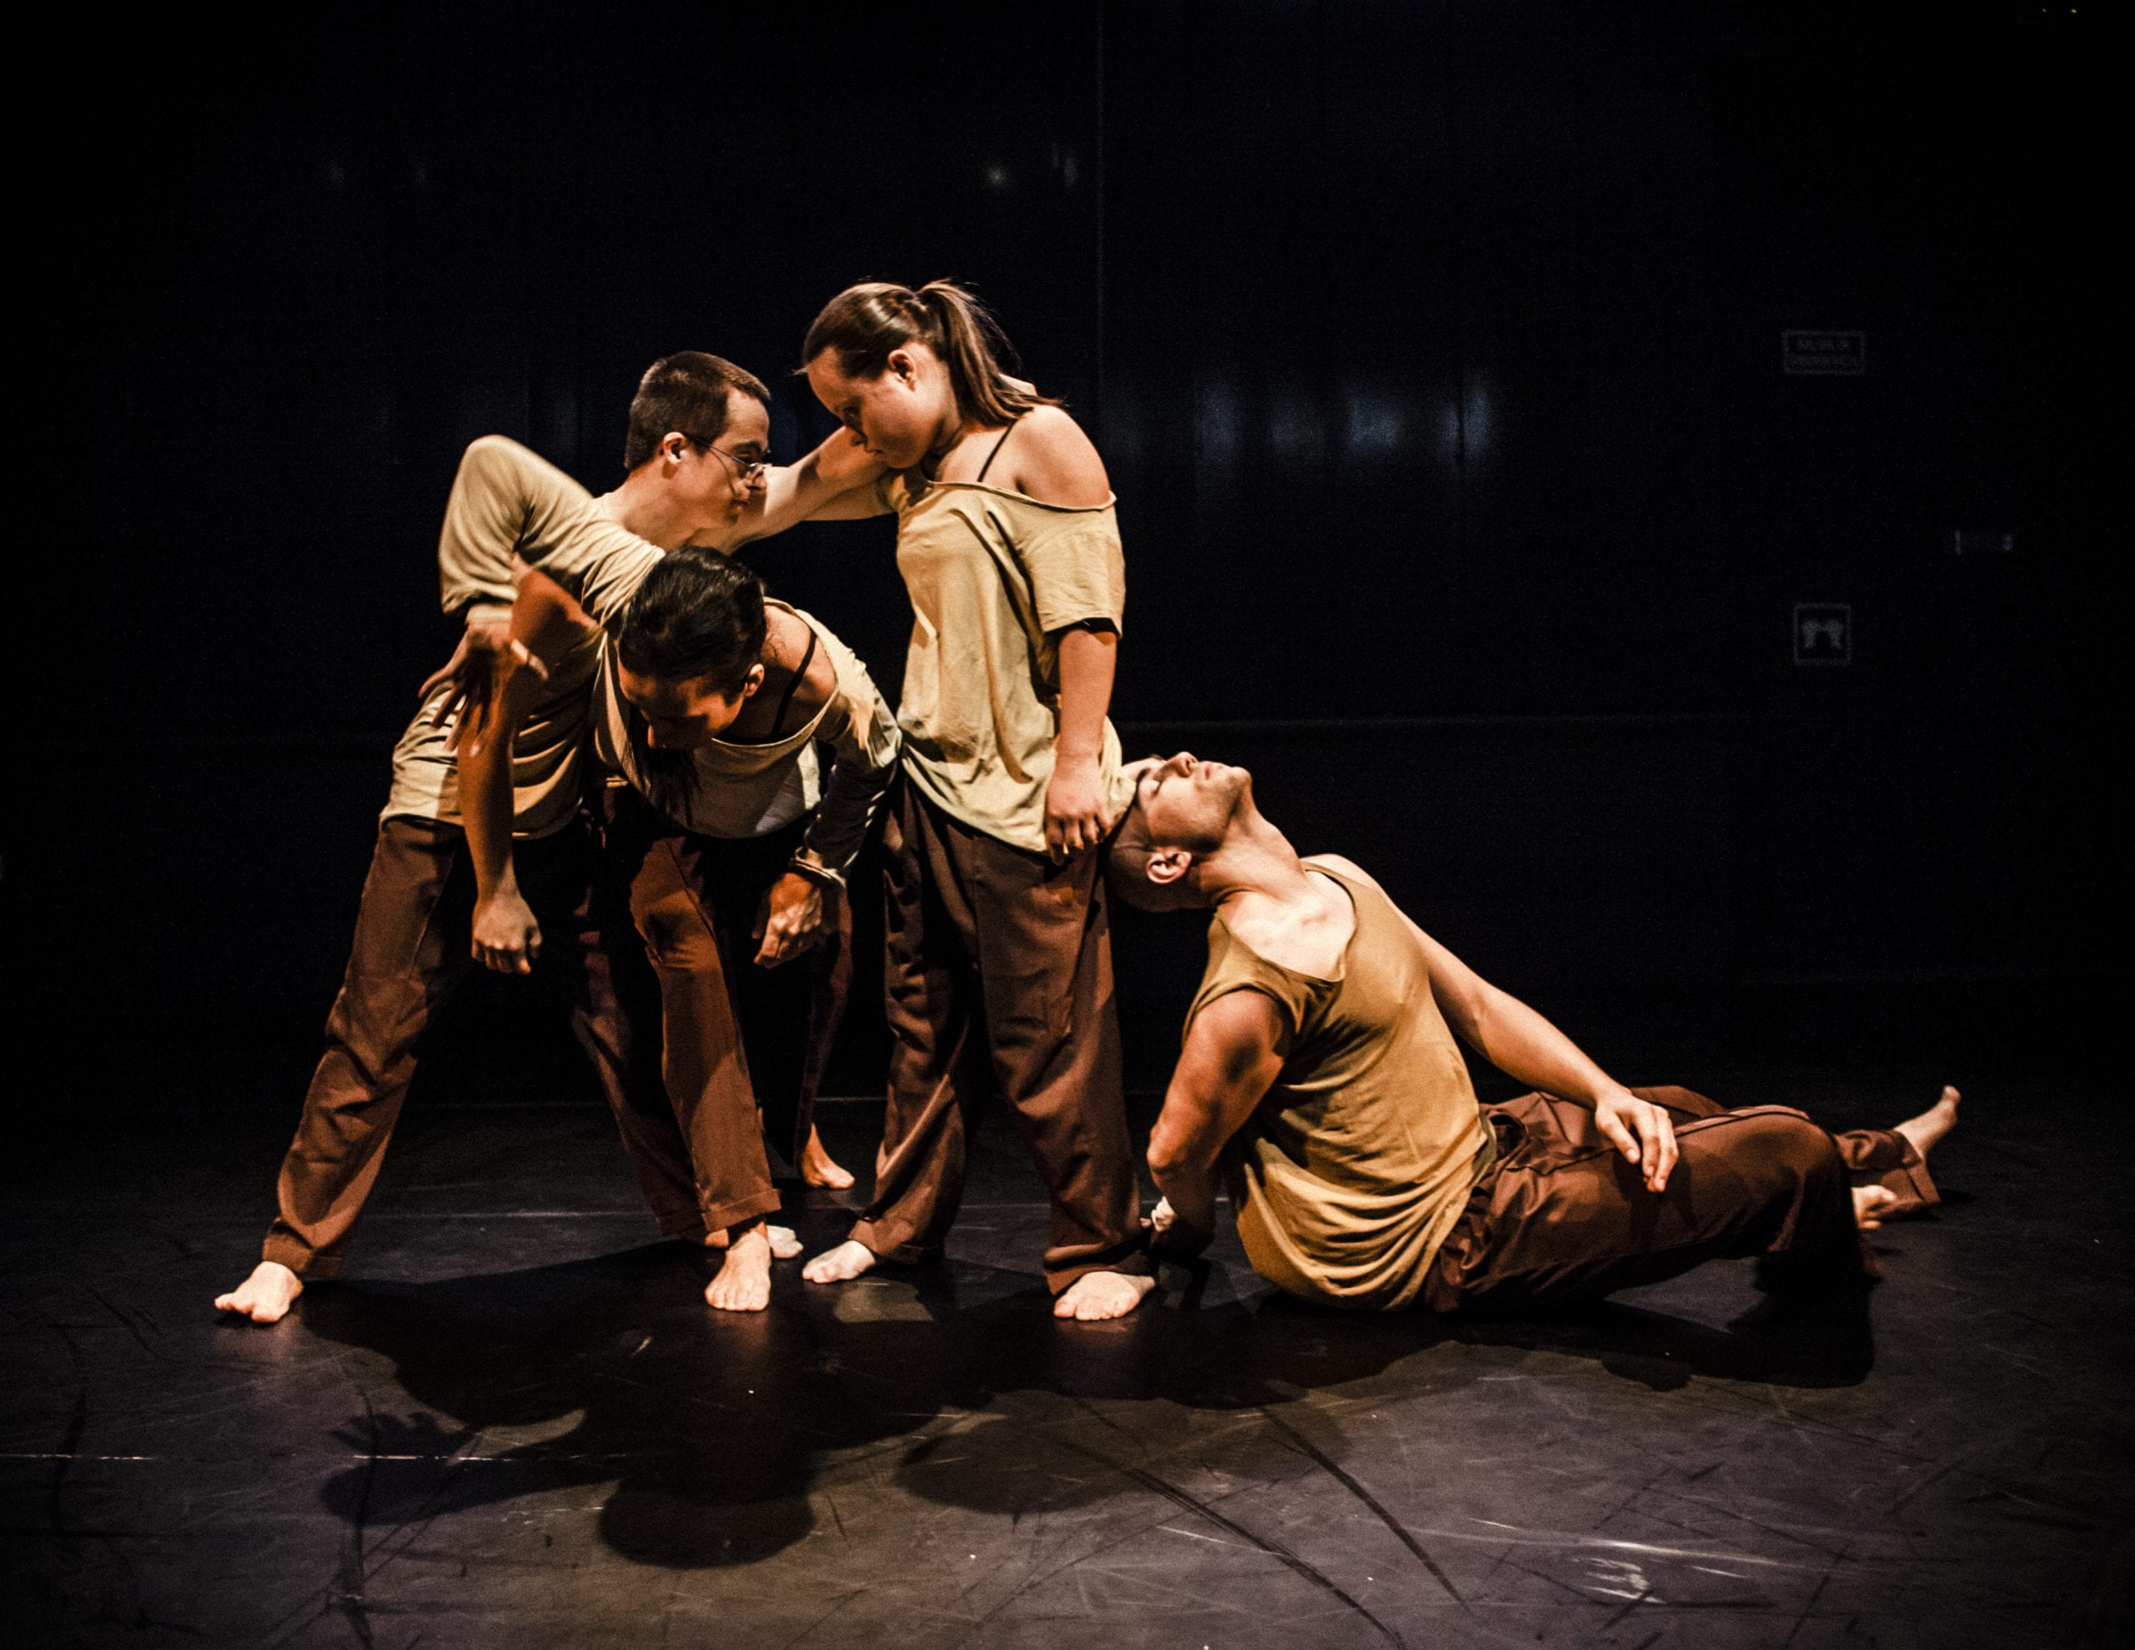
Apps
1. CVT Connect
Our own digital platform where you can connect with friend and find out what is happening across the charity.
www.cvtconnect.org.uk
2. The Buzz
Videos made by people with a learning disability. Exercise to cooking and they all free
https://www.facebook.com/groups/hellothebuzz
3. Dance syndrome
Pre-recorded dance sessions
https://www.facebook.com/dancerleddisabilityinspired/
4. Auto No Me
A fantastic app for people with a learning disability to develop skills for independence. They are offering the app for free over lockdown
https://www.autono.me.uk/covid-19

Slide 5
Printed resources
1. Sense
Sign up for weekly activity packs via email
Free sign language sessions
https://www.sense.org.uk/sense-sign-school/
Autonomy
Printed activity packs
https://www.sense.org.uk/get-support/arts-sport-and-wellbeing/
2. ELSA
Some great mindfulness resources
https://www.elsa-support.co.uk/category/free-resources/
3. Free Open University courses
Learn a language for free
www.duolingo.com ·
Free science lessons
mysteryscience.com
https://www.open.edu/openlearn/free-courses/full-catalogue ·

Slide 6
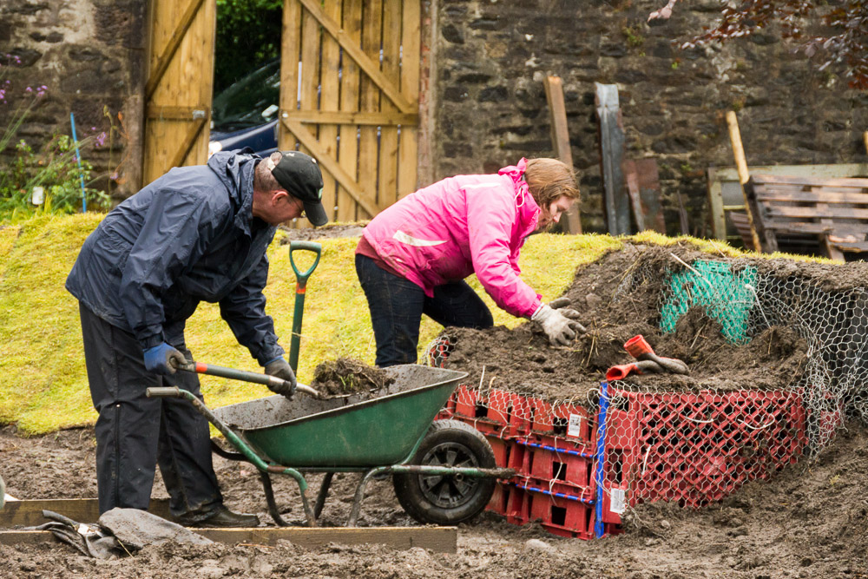
On line
1. Mencap
Lots of easy read information
https://www.mencap.org.uk/advice-and-support
2. Sport and fitness
https://www.downs-syndrome.org.uk/coronavirus-covid-19/keeping-fit-and-healthy-at-home/
https://www.sportengland.org/jointhemovement
3. Nature
https://www.sensorytrust.org.uk/resources/activities?fbclid=IwAR33ZEDipJx0P9-HUI8087krM4RkKP7mayMimDwR_SXZ-UuCxTMCpZpQQ2k
4. Arts and crafts
https://www.creativebug.com/classes
64 Million Artists are launching a January art challenge and there is an easy read guide too
https://64millionartists.com/our-work/the-january-challenge/

Slide 7
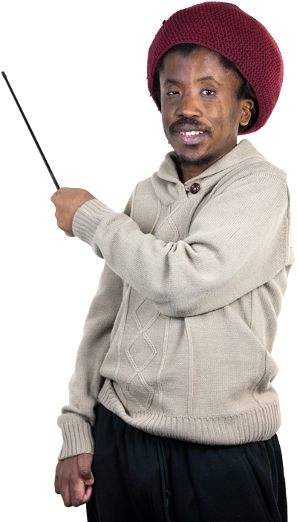
Finally
1. BBC Two
Support for the GCSE curriculum, Shakespeare plays, science, history.
Can access on the red button or on BBC iplayer.
2. Church’s together in England
https://www.cte.org.uk/Groups/234772/Home/Contacts/Member_Churches.
Get in touch
Delrow. cian.davis@cvt.org.uk
St Albans. christelle.newbury_olive@cvt.org.uk
Larchfield. deborah.smith@cvt.org.uk
The Croft and Stourbridge. philip.gibson@cvt.org.uk
Oaklands. janet.hawkins@cvt.org.uk
Botton. colin.buck@cvt.org.uk
Grange. peter.harper@cvt.org.uk
Colin Buck
The Old Store
Botton Village
Danby
North Yorkshire
YO21 2NJ
Notes:
This is a blank starter page for Photosymbols Easy Read Templates.

