Slide 1
The Good Lives Framework March 2022

Slide 2
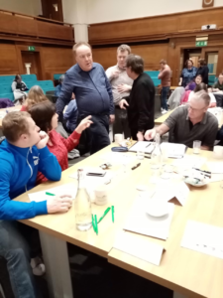
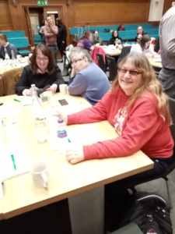
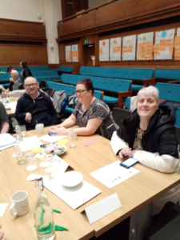
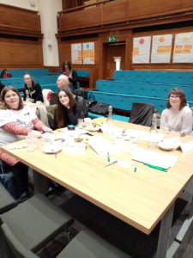
Birmingham February 2020

Slide 3
What self advocates told us is important
Self advocates lead on what is most important
Focus on rights
Be positive and offer solutions
Learning Disability England host not control

Slide 4
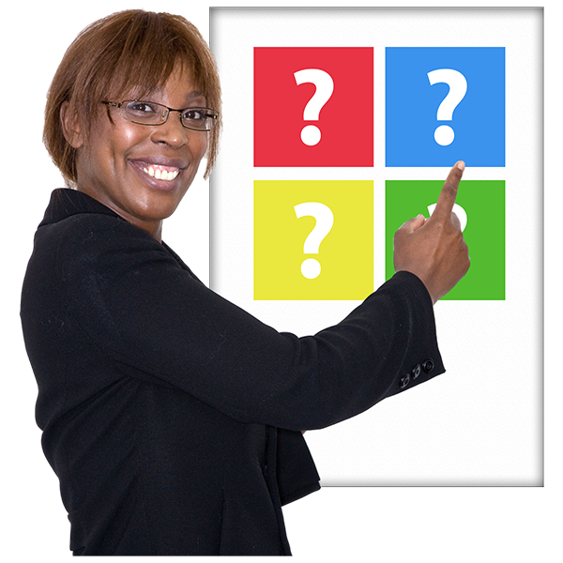
The most important issues to start work on What people said in summer 2020
• Self-advocacy and Advocacy
• Good health
• The Right Support
• Communication and staying connected
• Paid Jobs
• Love, Sex and Relationships

Slide 5
How the framework is laid out
There are 6 chapters at the moment
We hope people will work together to add more

Slide 6
The United Nations Convention on the rights of person with disabilities (UNCPRD)
An agreement between countries
Countries say they will not treat people differently because they are disabled

Slide 7
How the framework is laid out
Each chapter says
1. What the United Nation Convention says about each topic
2. What people with learning disabilities have said needs to change
3. What people said would change things

Slide 8
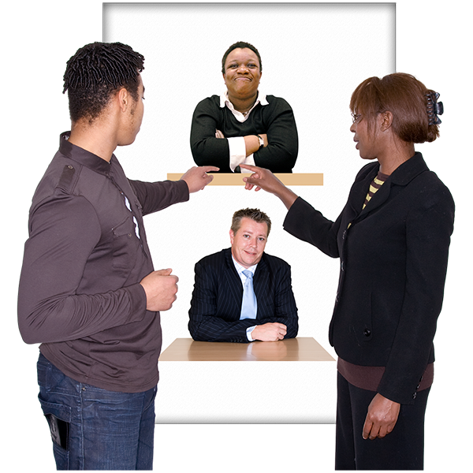
The chapters
A Home
Communication and Staying Connected
The Right Support

Slide 9
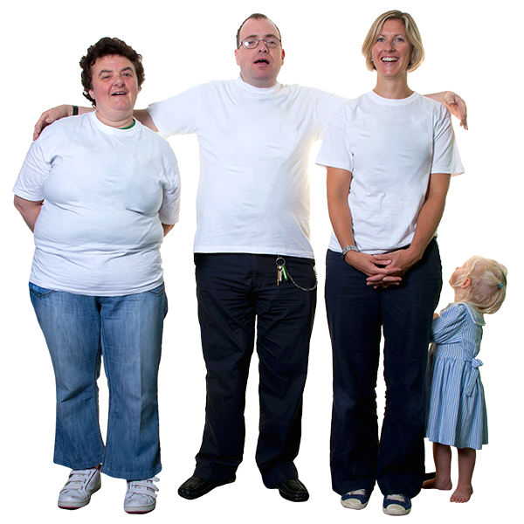
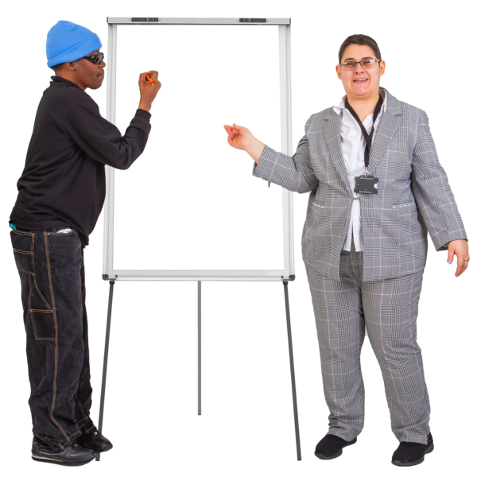
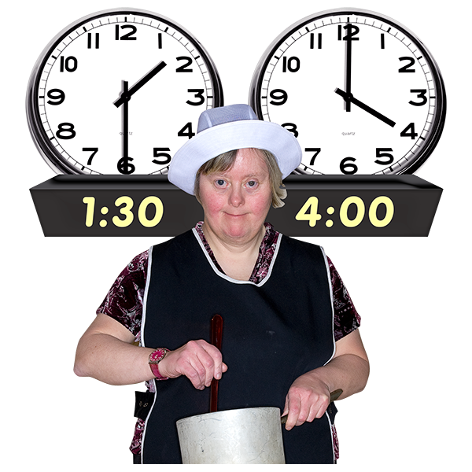
The chapters
To Love and Be Loved
Advocacy and Self Advocacy
Employment and Contribution

Slide 10
Home
The UN Convention says
Disabled people should get the same choices as non-disabled people.
They should be able to live in the community, not separately.

Slide 11
Home – Action to take
1. Councils and services need to work together with people and their families to make sure people with learning disabilities get the homes they want and need.

Slide 12
Home – Action to take
2. The Government needs to fund more homes that are right for people with learning disabilities and make sure there is money to pay rent and live.

Slide 13
Home – Action to take
3. Councils need to have enough housing options for people with learning disabilities and offer financial support to help them live good lives, be independent and feel more connected to their communities.

Slide 14
Home – Action to take
4. People with learning disabilities need to be provided with high-quality information and support to help them access housing that’s right for them.

Slide 15
Communication and Staying Connected
The UN Convention says
Disabled people should have freedom of expression and opinion.
Access to information is important.

Slide 16
Communication and Staying Connected – Action to take
1. People who support someone with learning disabilities at home and people who support them outside of the home need to work together.
They can help people with learning disabilities who need extra help to communicate by sharing knowledge and experience.

Slide 17
Communication and Staying Connected – Action to take
2. We need to share examples of how technology was used during the pandemic to help people with learning disabilities connect and live well.

Slide 18
Communication and Staying Connected – Action to take
3. Health and social care providers need to make sure their information is easy for people with learning disabilities to find and to understand.

Slide 19
Communication and Staying Connected – Action to take
4. Everyone needs to work together to make sure people with learning disabilities have computers and can connect to the internet.
We also need to make sure people with learning disabilities and the people who support them get good training and support on how to use technology.

Slide 20
Communication and Staying Connected – Action to take
5. Local councils need to find out what communication support there is for people with higher support needs.
They need to make sure people get the support and the technology they need to communicate well.
Things like speech and language therapy.

Slide 21
Communication and Staying Connected – Action to take
6. People with learning disabilities and their carers need to know it is their right to have the help and support they need so they can communicate well.

Slide 22
The Right Support
The UN Convention says
People with disabilities should get the help they need to live well and feel included.

Slide 23
The Right Support - Action to take
1. We need to make sure people with learning disabilities and their families are the ones who decide whether a service is good at supporting them or not.

Slide 24
The Right Support - Action to take
2. The Government, local councils and service providers need to work more closely with people with learning disabilities to develop services and support.

Slide 25
The Right Support - Action to take
3. Support should be based on the REACH Standards.
The REACH Standards look at how people with learning disabilities can live a good, ordinary life.

Slide 26
The Right Support - Action to take
4. People with learning disabilities, their families and the people who support them need to work together more.
They need to tell each other what is not working well and things they are not happy about.
For example, some overnight support workers only being paid when they are awake and not when they are sleeping.

Slide 27
To Love and Be Loved
The UN Convention says
Respect for home and the family.
Personal and intimate relationships are important for people with learning disabilities.

Slide 28
To Love and Be Loved - Action to take
1. Providers of support services need to follow the No Bedtimes guidance developed by the charity Stay Up Late.
The guide has been created to help people with learning disabilities enjoy evenings out and have a full and active social life.

Slide 29
To Love and Be Loved - Action to take
2. Providers of support services need to work together to promote that people with learning disabilities have the right to love others and be loved.

Slide 30
To Love and Be Loved - Action to take
3. During its inspections, the Care Quality Commission needs to check if people are receiving the support they need to express their sexuality.
A CQC inspection also needs to look at if people are getting support and education to have close relationships and maintain them if that is what they need.

Slide 31
To Love and Be Loved - Action to take
4. Local councils and service providers should give people the support they need to have a good family life and relationships.

Slide 32
To Love and Be Loved - Action to take
5. All social care workers need to receive training on how they can help people express their sexuality and have close relationships.

Slide 33
To Love and Be Loved - Action to take
6. The REACH Standards should be met to help people with learning disabilities live a good, ordinary life.
This includes them having the freedom to choose their relationships.

Slide 34
To Love and Be Loved - Action to take
7. A large campaign needs to be launched to raise awareness of the sexual rights of people with learning disabilities.

Slide 35
Advocacy and Self Advocacy
The UN Convention says
There should be equality and respect for people with a disability.
It is important that people with learning disabilities can speak up for themselves and what is important to them.

Slide 36
Advocacy and Self Advocacy - Action to take
1. We need to help self-advocacy organisations grow and get stronger so they can help more people with learning disabilities speak up for themselves.

Slide 37
Advocacy and Self Advocacy - Action to take
2. The Government needs to help self-advocacy organisations connect with each other so they can achieve big changes through the Disability Strategy.

Slide 38
Advocacy and Self Advocacy - Action to take
3. The Government must work with people with learning disabilities before making decisions that affect the lives of people with learning disabilities.

Slide 39
Advocacy and Self Advocacy - Action to take
4. People with learning disabilities should always be asked to lead, be part of or speak at events or meetings about people with learning disabilities.

Slide 40
Advocacy and Self Advocacy - Action to take
5. We need to create one online space where people can access easy-to-understand information that will help them speak up for themselves.

Slide 41
Advocacy and Self Advocacy - Action to take
6. People who plan services need to share good ideas about how self advocacy groups can earn money to help them be more independent.

Slide 42
Advocacy and Self Advocacy - Action to take
7. We need a quality scheme and mark that shows people with learning disabilities have helped to create information materials or led that work.
The scheme and mark should also be used to show that people with learning disabilities have helped to create, or are delivering, a service.

Slide 43
Employment and Contribution
The UN Convention says
Work and employment for people with a disability is important.

Slide 44
Employment and Contribution - Action to take
1. Organisations that support people with learning disabilities must make sure everyone can contribute to society though work, volunteering or another way.

Slide 45
Employment and Contribution - Action to take
2. The Government needs to find out and tell us how many people with learning disabilities have a paid job.

Slide 46
Employment and Contribution - Action to take
3. The Government needs to invest money so local employers can provide high-quality support that helps people with learning disabilities work.

Slide 47
Employment and Contribution - Action to take
4. The Government needs to work with people with learning disabilities and employers to develop guidelines on providing good employment support.

Slide 48
Employment and Contribution - Action to take
5. The Government needs to make sure the Access to Work scheme and welfare benefits help more people with learning disabilities to work.

Slide 49
Employment and Contribution - Action to take
6. Local councils should find out how many people with learning disabilities have a paid job in their area.
This number could then be used to check if local services are giving good support to help people find, get and keep a job.

Slide 50
Employment and Contribution - Action to take
7. From an early age onwards, we must inspire and tell people with learning disabilities that they can contribute to society.
This includes telling them about their rights and sharing success stories.

Slide 51
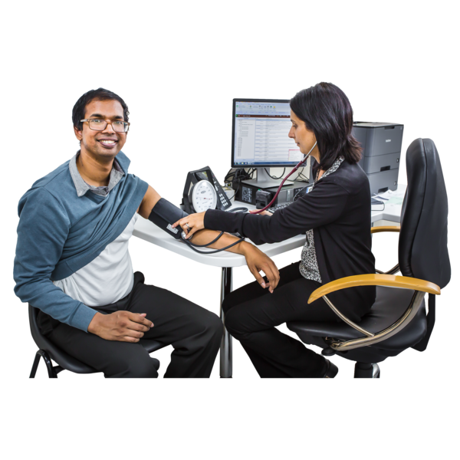
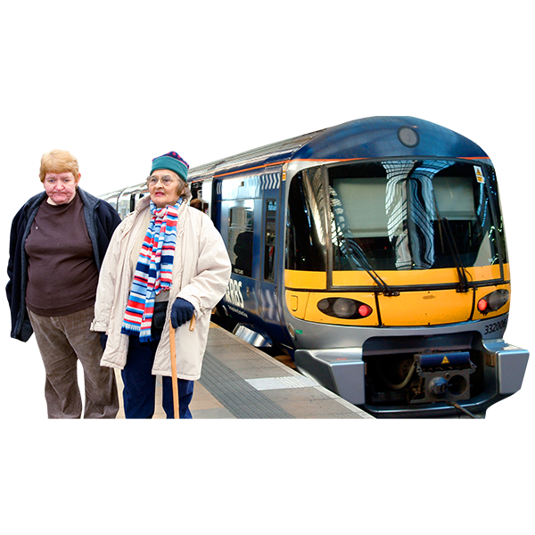
We know there are things missing
This is a start not everything
Important things like health or accessible travel are missing
We hope people will add those

Slide 52
What some members told us already Some self advocacy reps met on 9th March
Health and wellbeing is more important now
Big issues that affect us all – climate change, cost of living
Share more examples of what is working – peer health educators
Make it an on going piece of work – keep adding
Get people on board – MPs, Councils, NHS, Councillors, Partnership Boards

Slide 53
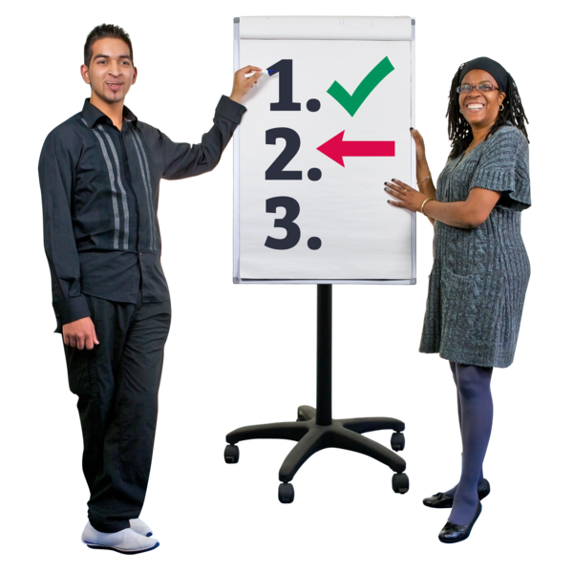
What next?
How can you, people you know or work with get involved?

Slide 54
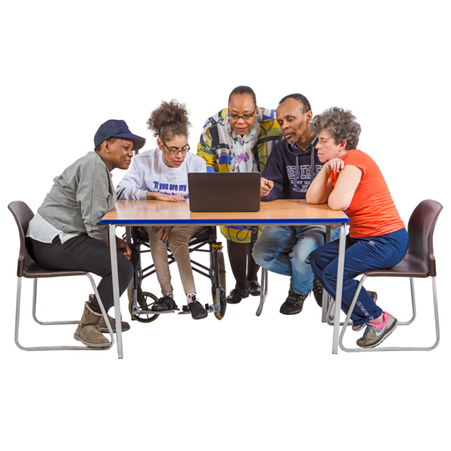
Next Steps – We are stronger together
Learning Disability England can help and host but not control this
As members, partners and friends what action can you take to make this happen?

