Slide 1


Slide 2

What is it?
Not enough information about the learning disability and autism sector
People with a learning disability and autistic people are less visible and people don’t talk about them as much as they should
Commissions research projects to improve understanding

Slide 3



Where did the idea come from?

Slide 4















Steering Group members – All these people agree with us!
Steering Group members

Slide 5

The Launch – media release
The only membership organisation specifically for learning disability and autism providers.

Slide 6
Sector Dashboard
An example of how ARC might present a future full sector dashboard – combining ARC data with other published sources:

Slide 7
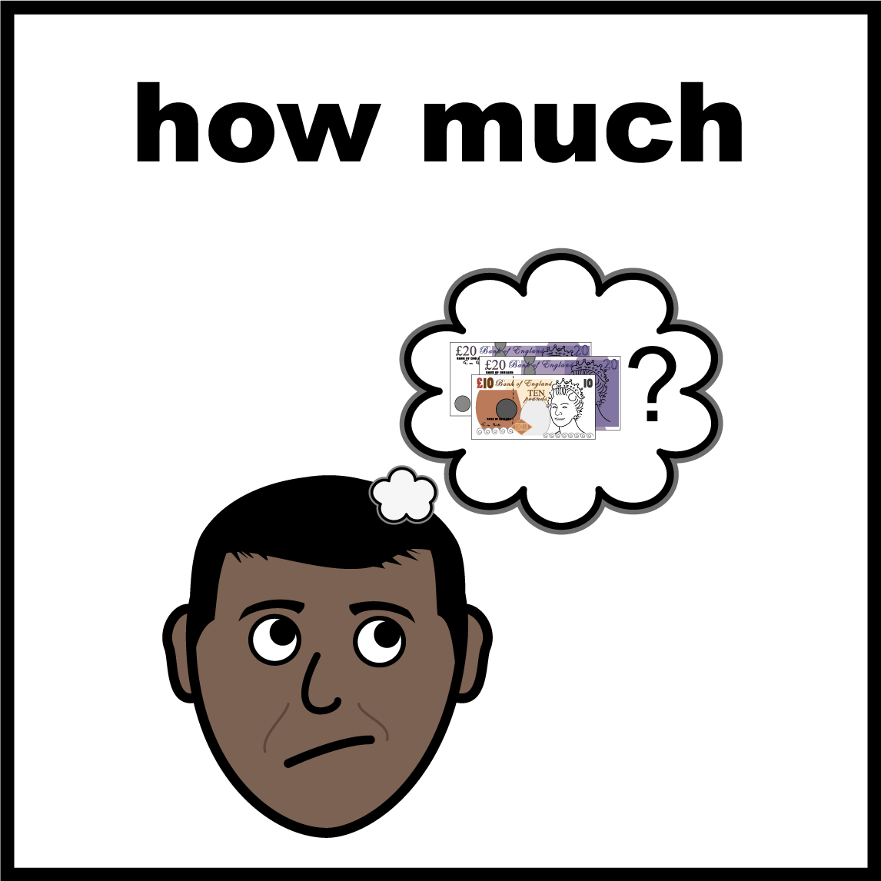
1st Research Project
How much Councils pay providers for learning disability and autism services
94% of Councils don’t pay enough!
Providers are struggling to keep going
We want the Government to make sure Councils pay enough so services are good and safe

Slide 8
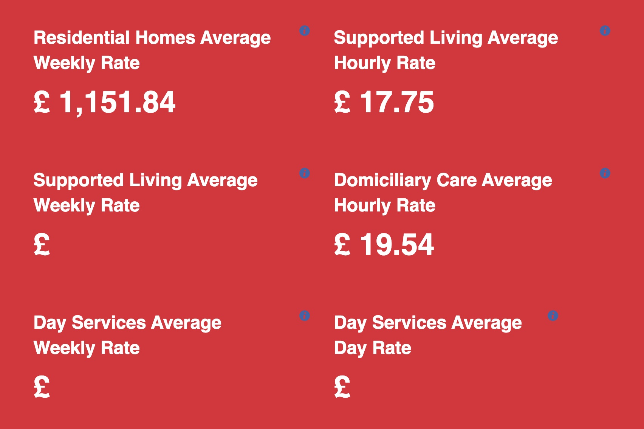
Councils are not paying enough for services!

Slide 9
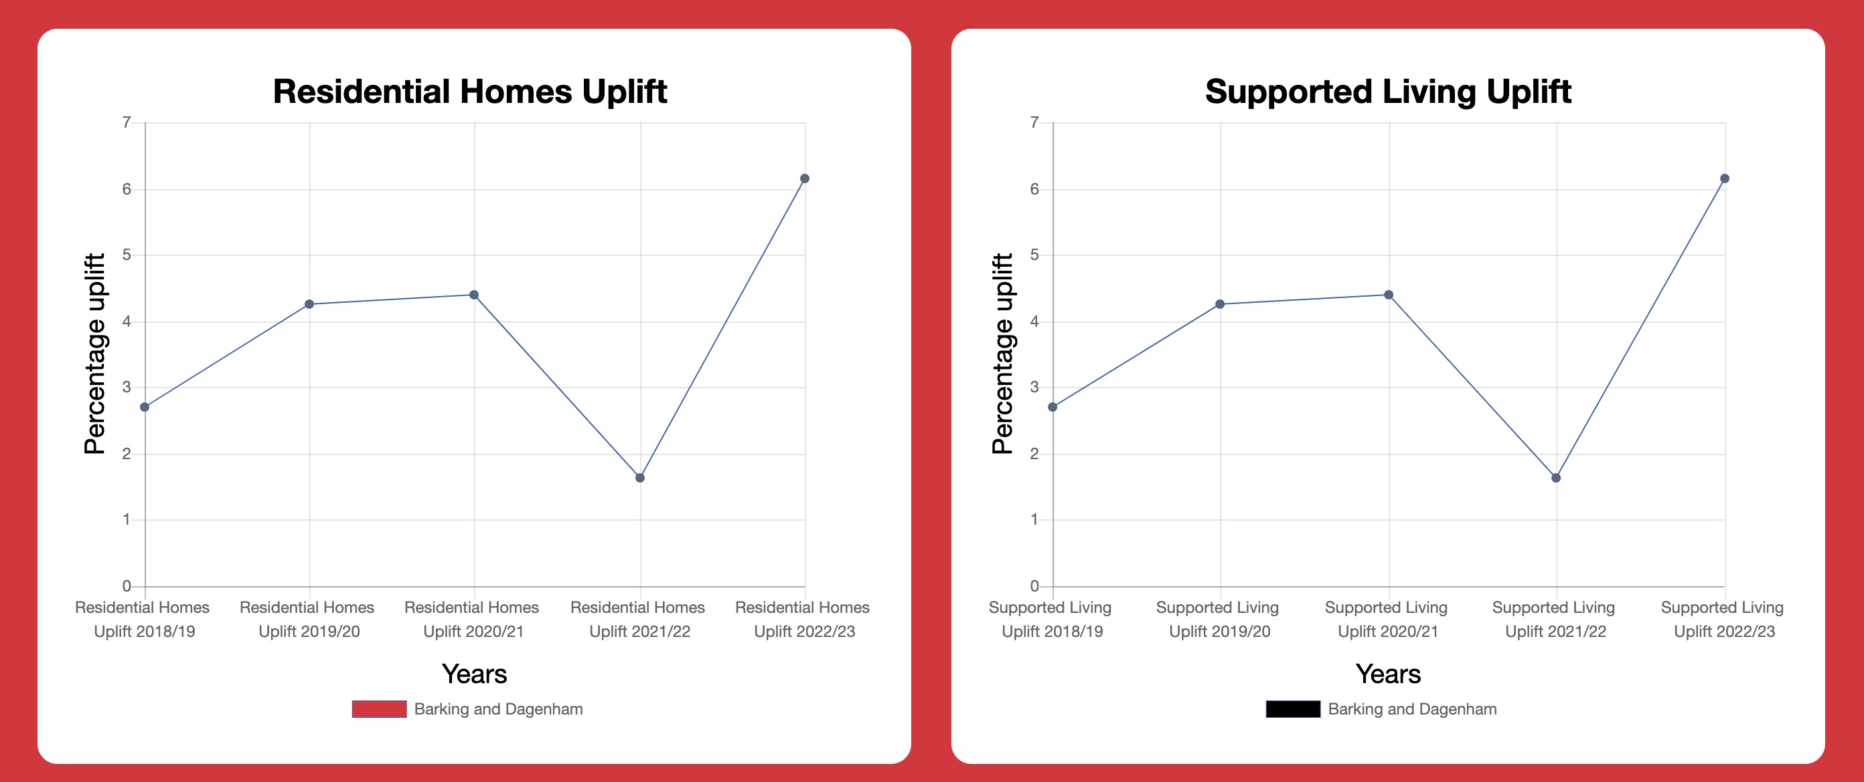
Councils are not paying enough for services!

Slide 10
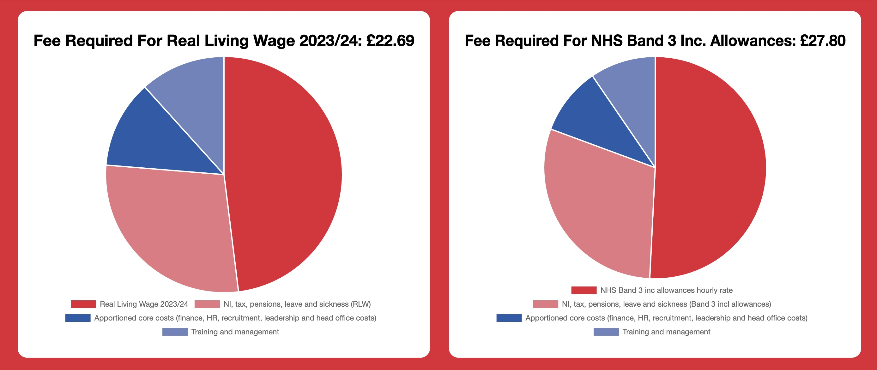
How much should they pay?

Slide 11

What’s next?
Chief Executive Officer confidence report
Social Care report – REACH standards
Sector Census

Slide 12

Any questions?

