Slide 1
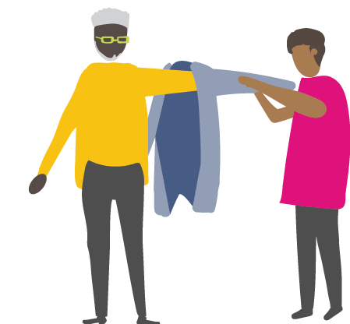
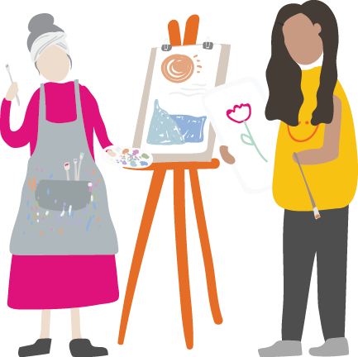
The right support, in the right way at the right time Community Catalysts Hertfordshire County Council Local Social

Slide 2
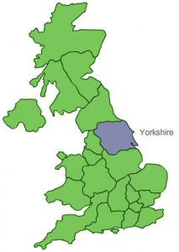
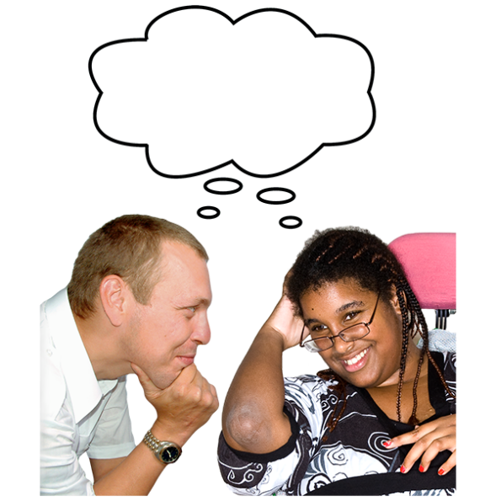
What is Community Catalysts
Small social enterprise
Based in Yorkshire
Work all over the UK
Work with people, communities, organisations and councils
Help them to think differently about the care and support that some people need

Slide 3
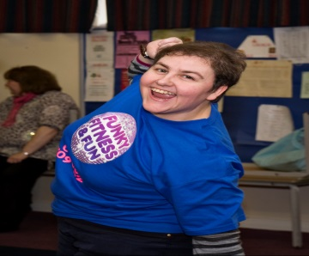
What does Community Catalysts do?
Help people who want to start
their own business
Help people who want to do
something for their community
Help people run their own activity
group
Give people more choice of:
What they do with their life
How they get the help they need to do it- right support right way at the right time!

Slide 4
Moving from serviceland (and serviceland thinking)

Slide 5
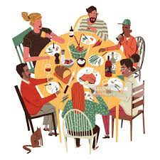
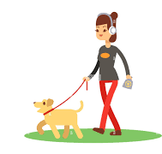
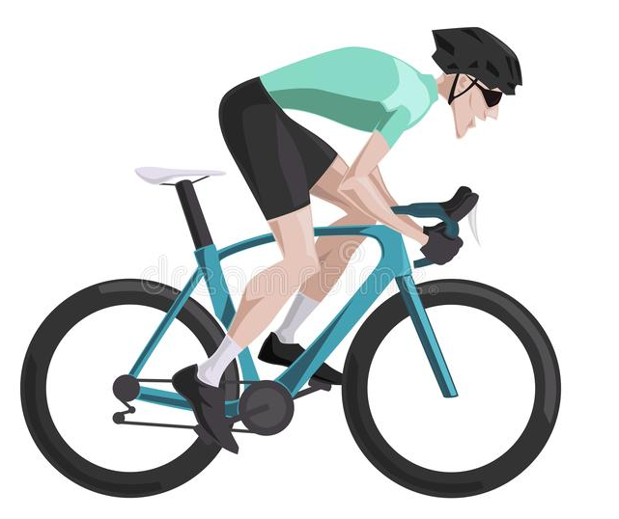
What does a good life look like to you?
Feedback from your partner …….

Slide 6
Helping people to get a good life ( not to be shown but spoken)
(Didn’t hear any words like; help to access the community/ inclusion/ having my personal care needs met!!! )
Recognise that one person’s good life is very different to another person’s. We need a range of local support All delivered by people as different as the people who may want to use them- we call these community micro-enterprises
People need real choice of a wide range of great local support – not just social care, health services and employed PA’s.
We need councils to commit to new ways of working. Give people real control via Direct Payments to pay for some support and make use of any free stuff. We need to bring social care/ health care staff on the journey
Sam in Hertfordshire – moving in the right direction

Slide 8
The challenges around using Direct Payments

Slide 9
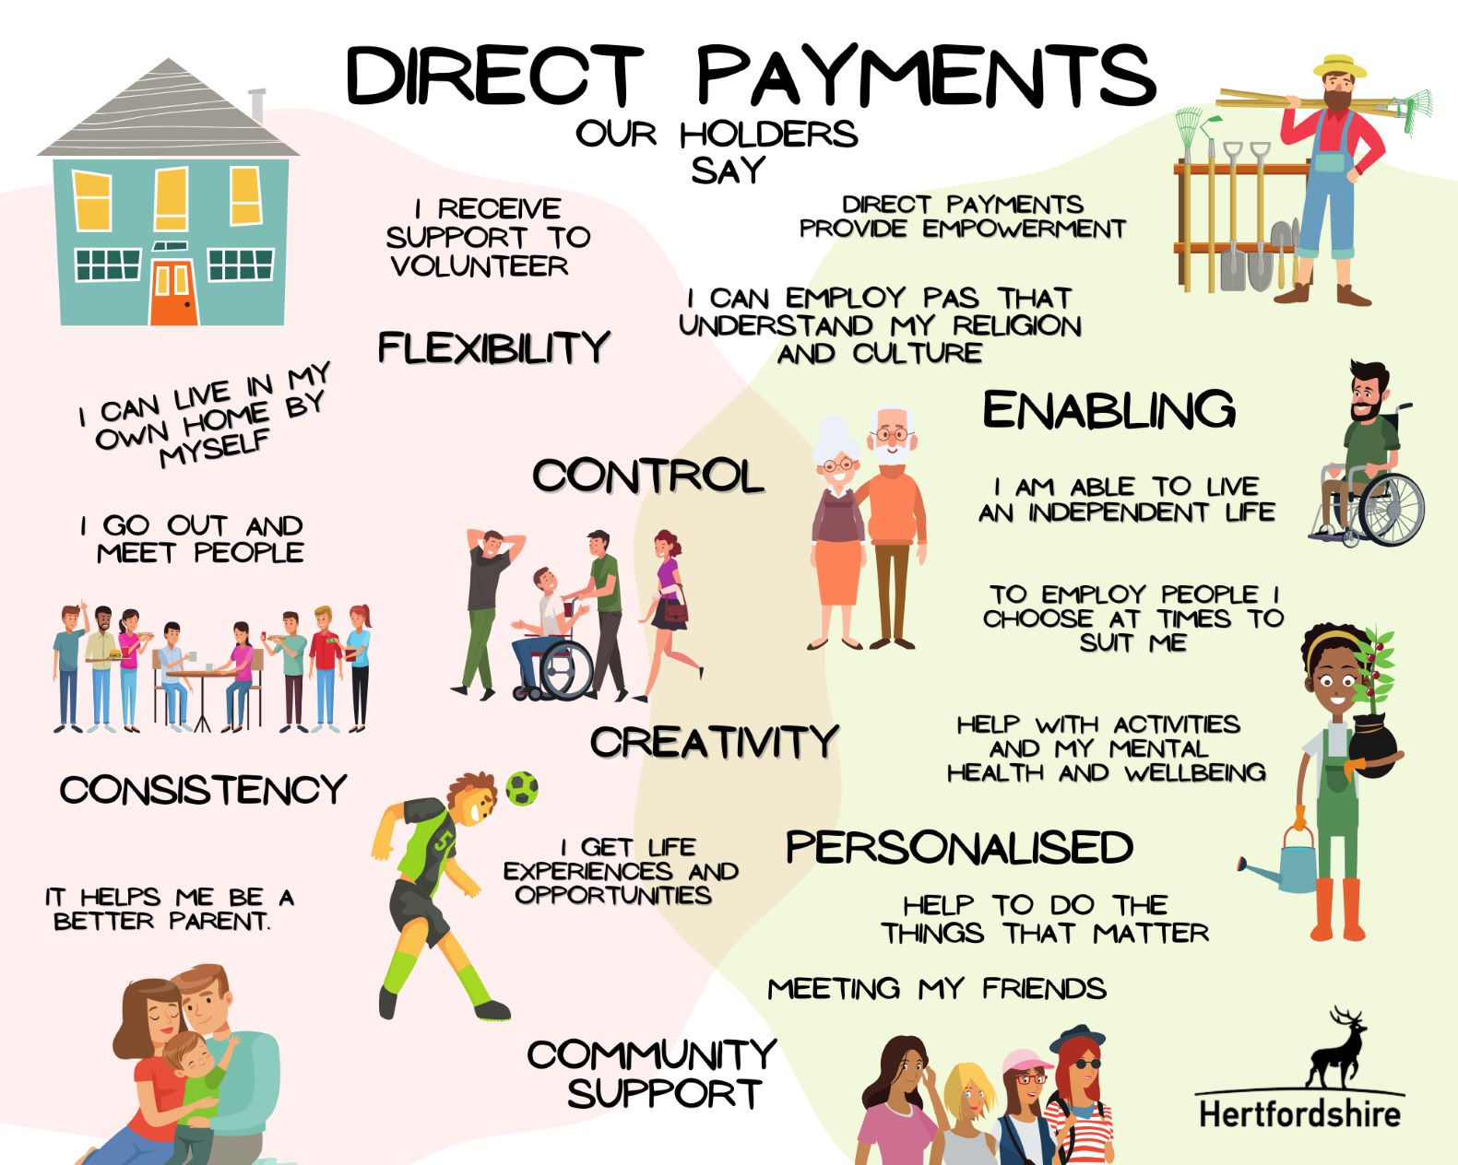
Here’s why Direct Payments needs to be personal

