Slide 1
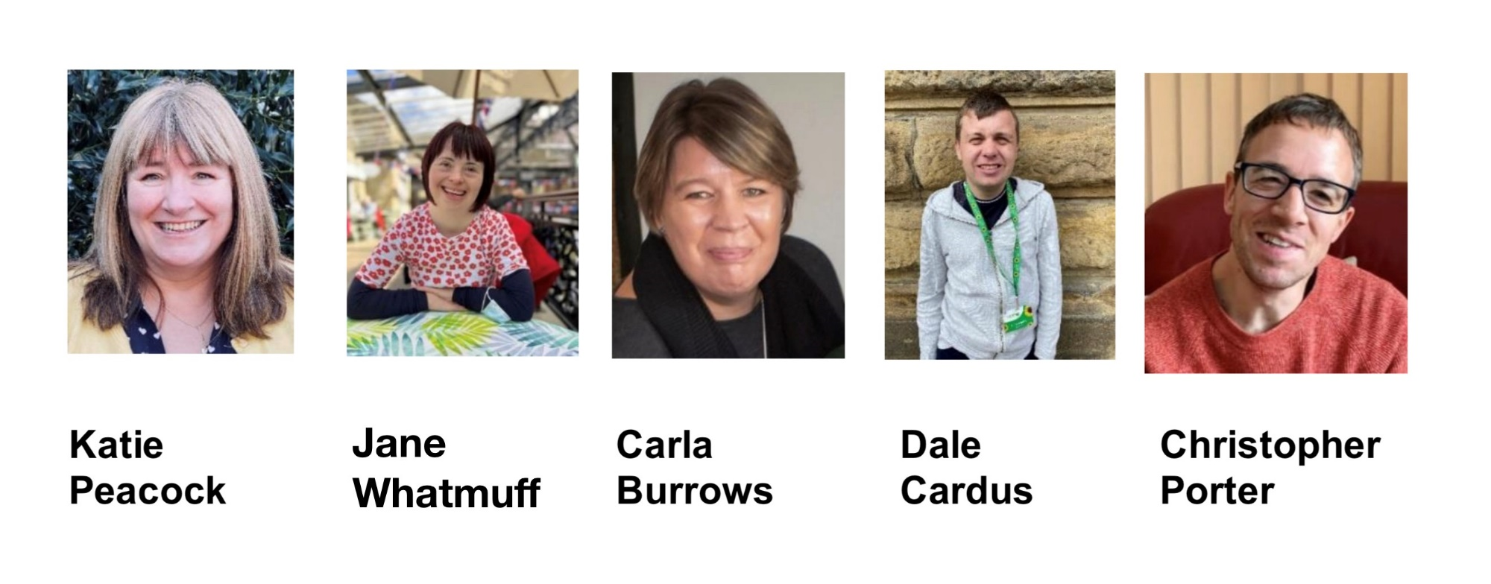
Building Community for Inclusion
Exclusively Inclusive

Slide 2
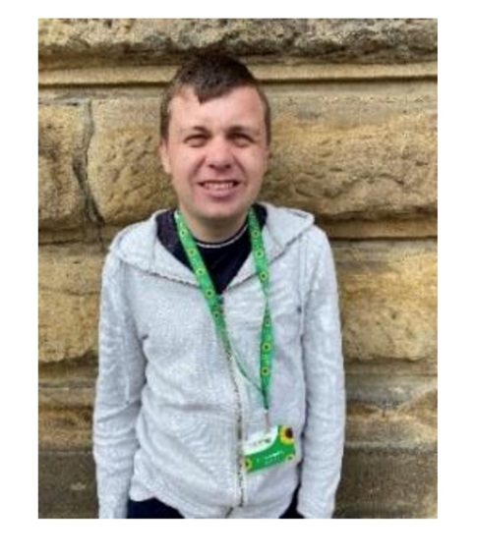
Welcome to our workshop!
Exclusively Inclusive is a voluntary community group that welcomes everyone to take part, it’s not only for people with Learning Disabilities, we want everyone to feel welcome to join in.
We are not a service and no one gets paid.

Slide 3
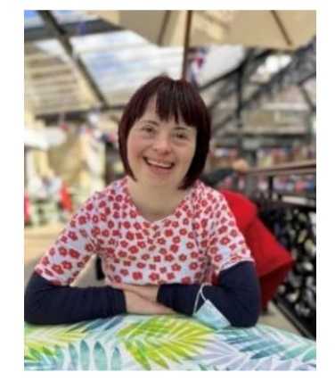
We are based in the Craven area of North Yorkshire and we are all about inclusion, friendship, belonging and creating opportunities for ourselves and others
to lead a good life.

Slide 4
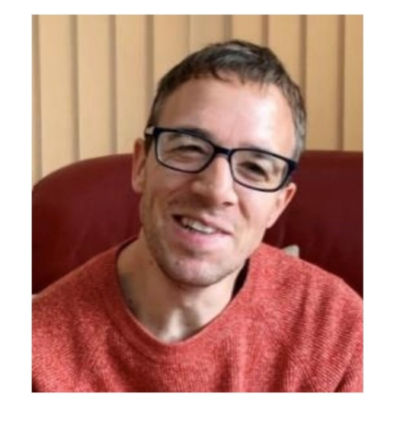
We want to tell you a little bit about us, how we started and then to show you a slide show of some
of the things we get up to.

Slide 5
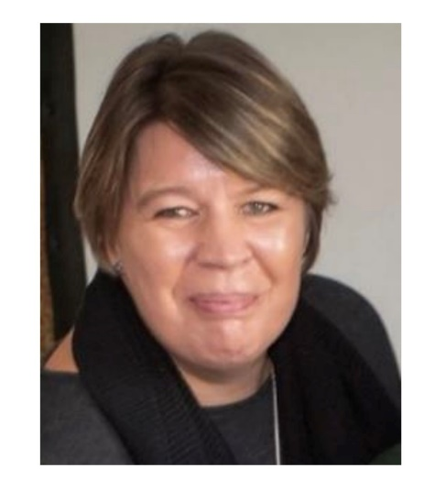
Then we will invite you to play our board game called “Making Connections, Building Community” that can help us think about what we can all do in our own neighbourhoods and communities
to help us lead good lives.
But first Katie will tell us a little bit of how it all began…

Slide 6
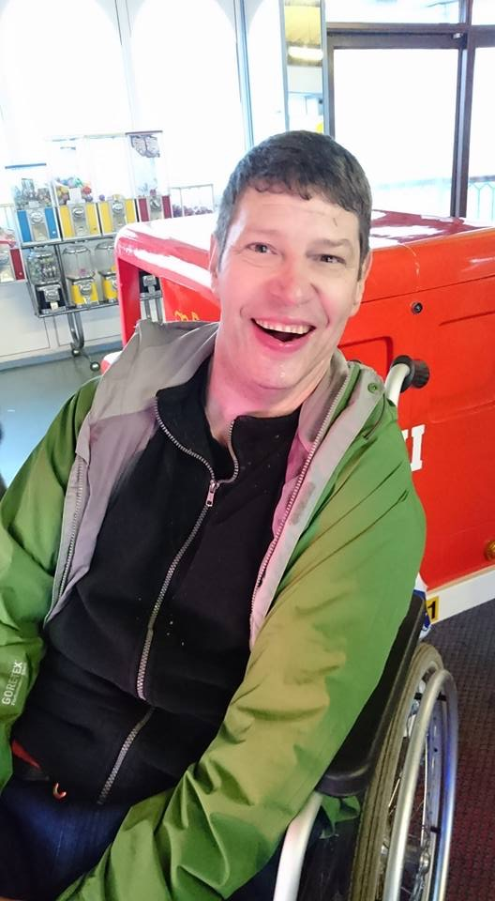
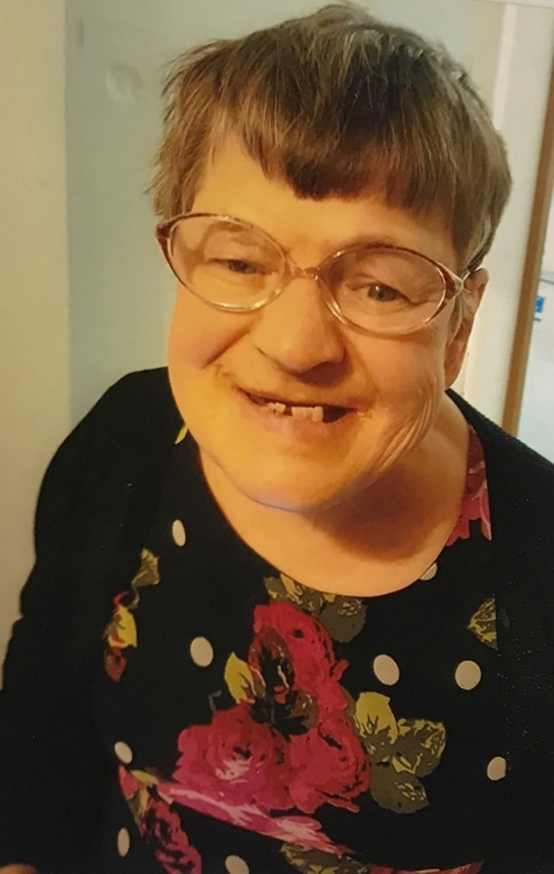
The inspiration behind Exclusively Inclusive
Gareth and Veronica

Slide 7
Happy Mondays Together – Social group with wellbeing focus
Building Connections – Lego Club
Be Friends Garden Gang - Allotment
Wellbeing Wednesday - Relaxation session on Zoom
Kin-ball - Fun physical activity
Come Dine with Us! - Cook together and eat together
Club ViVA 52 - Club night
Craven Gazette – our news magazine

Slide 8
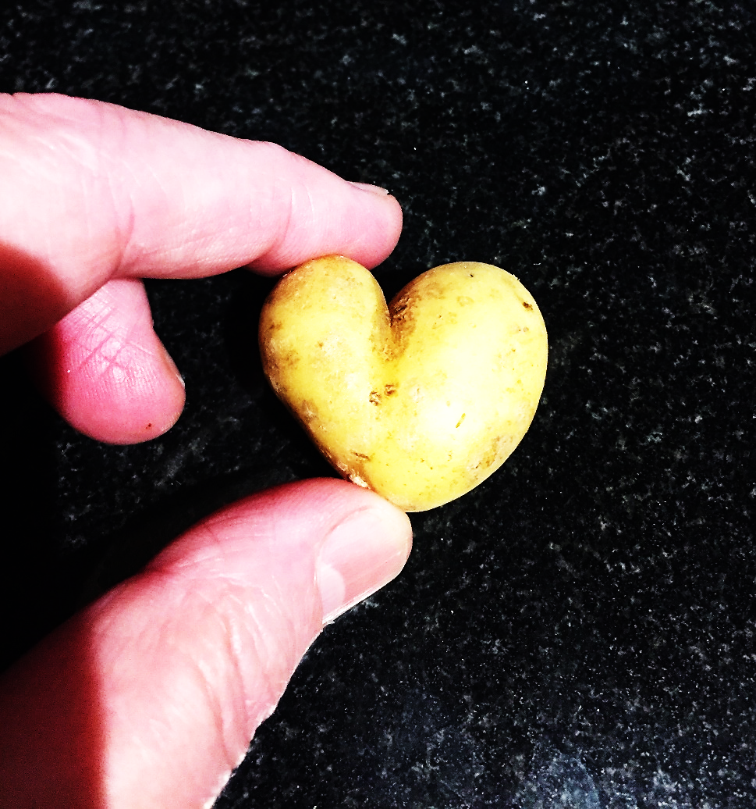
Feel free to sing or dance along
as you watch some of what we do!

Slide 9
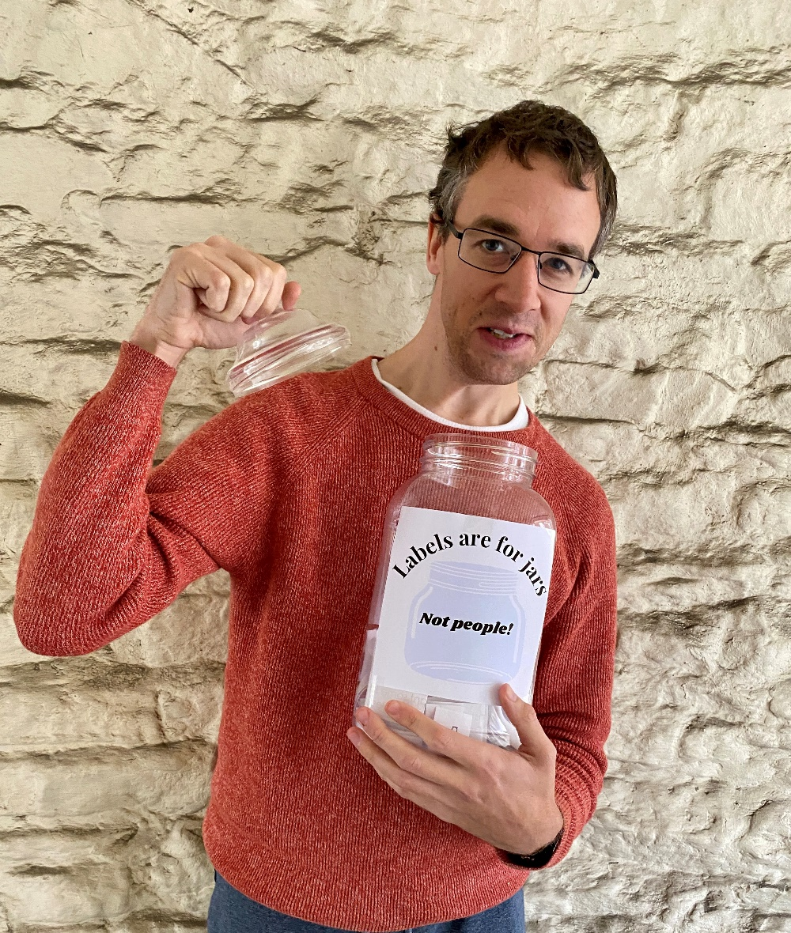
Encourage self advocacy!

Slide 10
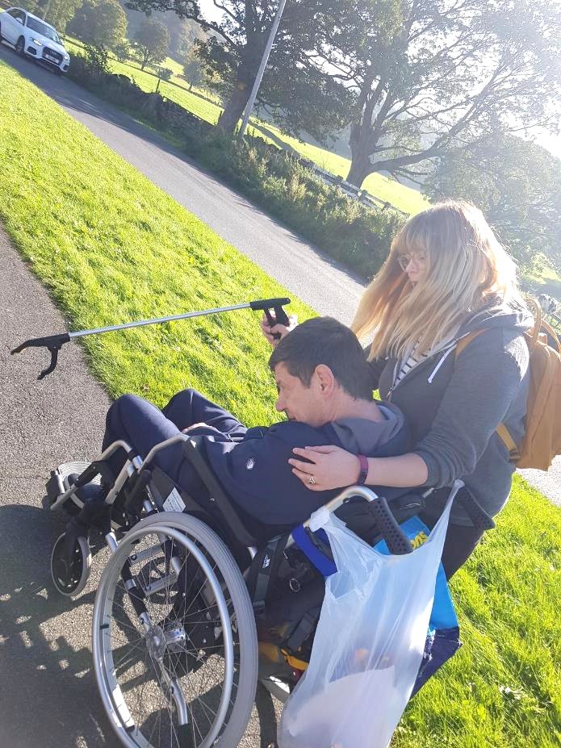
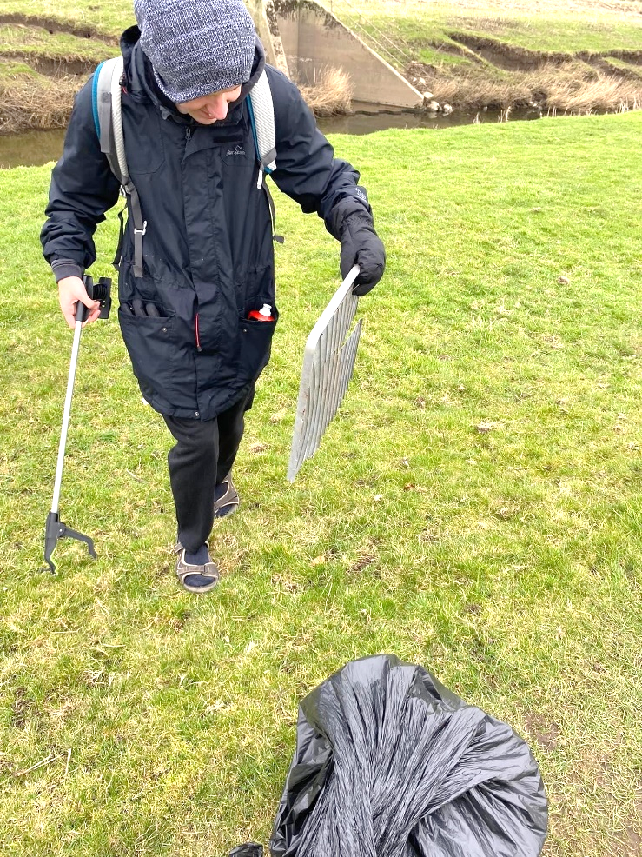
Take care of our environment

Slide 11
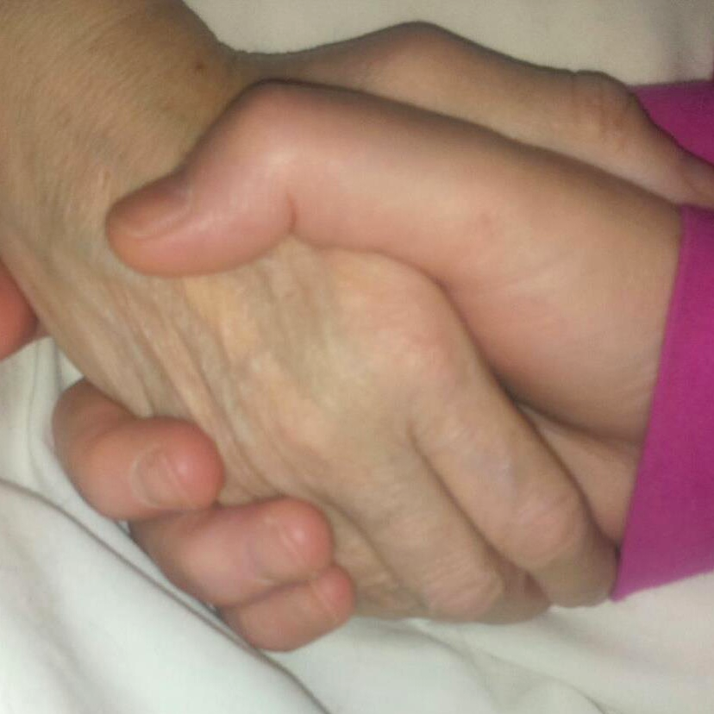
Be there and show we care

Slide 12
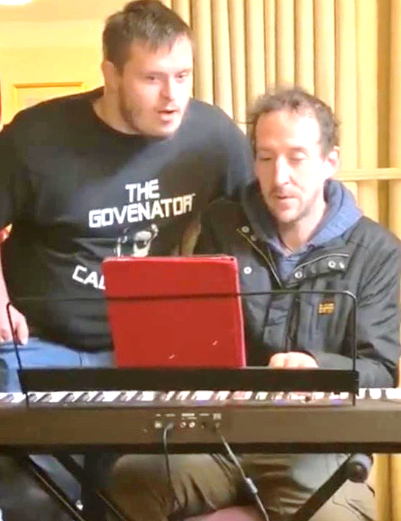
Invite people to share their skills with us!

Slide 13
Work together and support each other

Slide 14
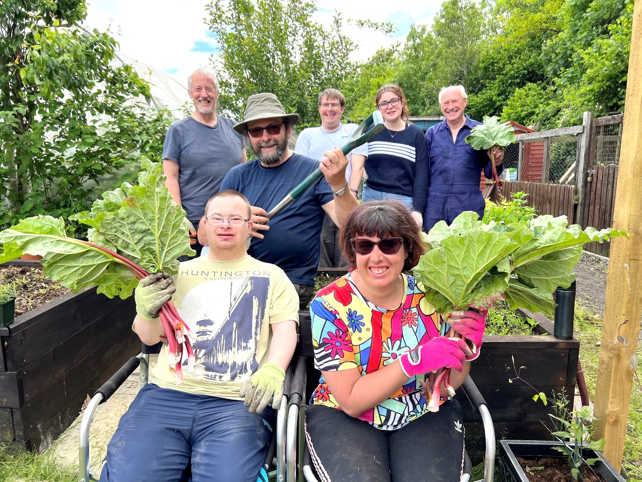
Come together on our allotment!

Slide 15
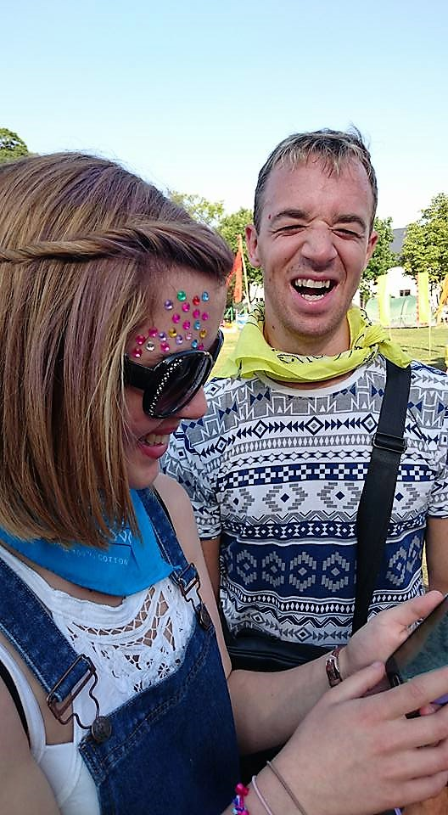
Have fun at festivals

Slide 16
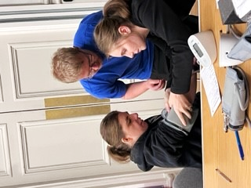
Make space to have our
Annual Health Checks in the community

Slide 17
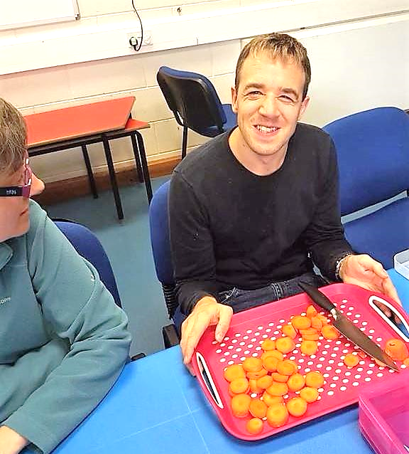
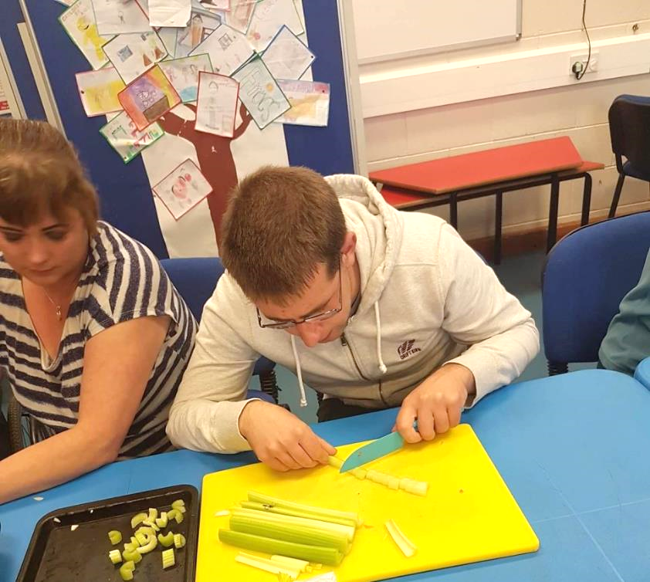
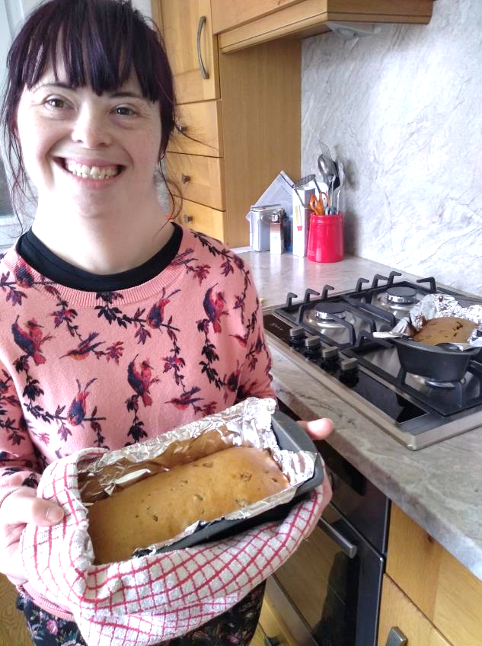
Come Dine with us?

Slide 18
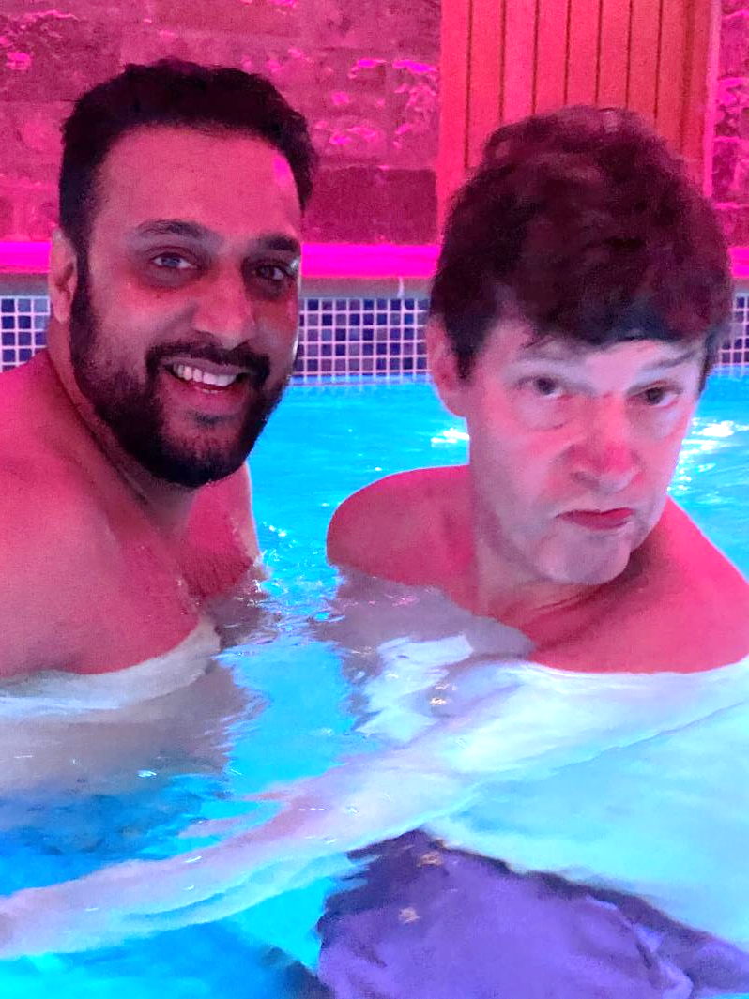
Have pool parties!

Slide 19
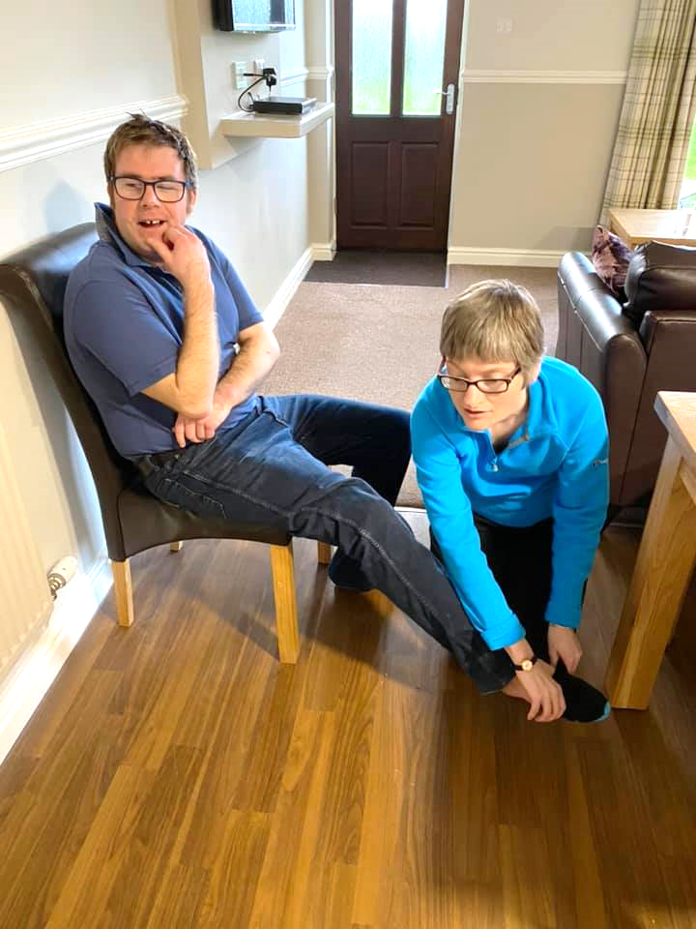
Give help as well as receive it!

Slide 20
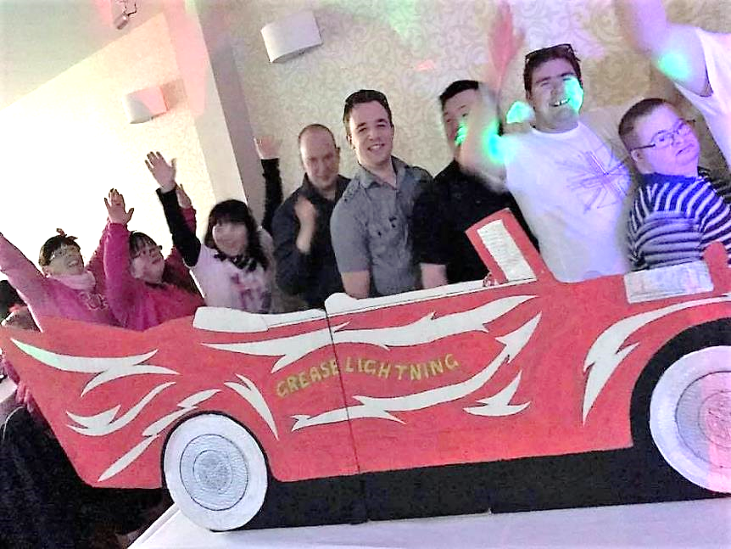
Party!!!
Grease is the word…

Slide 21
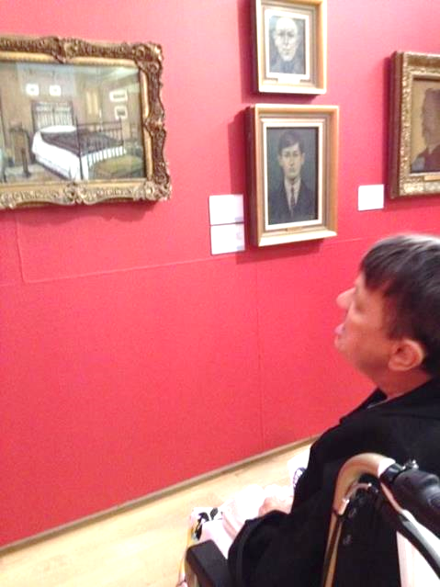
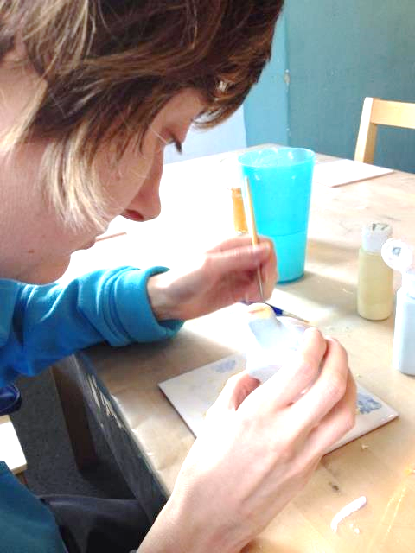
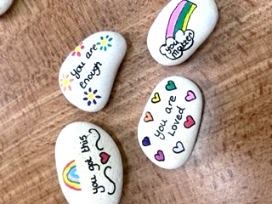
Appreciate art and be creative!

Slide 22
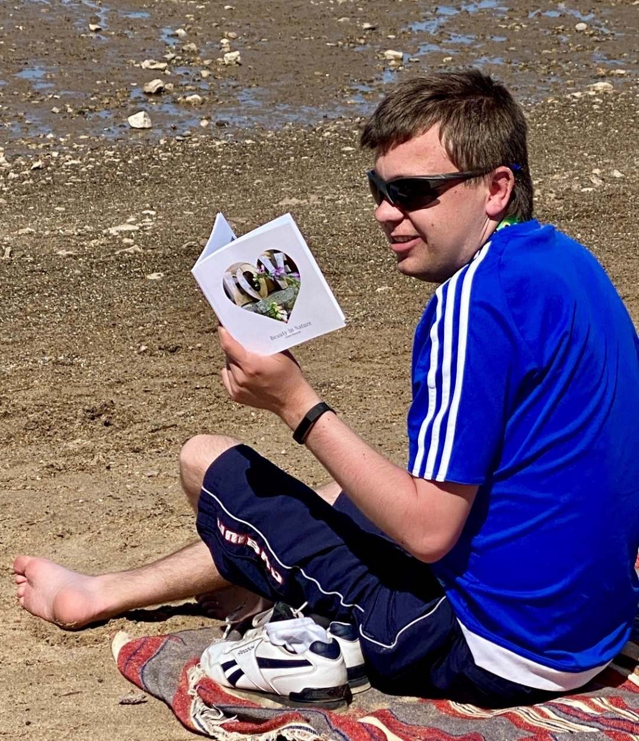
Take time for our wellbeing

Slide 23
Try new ideas and make them happen!

Slide 24
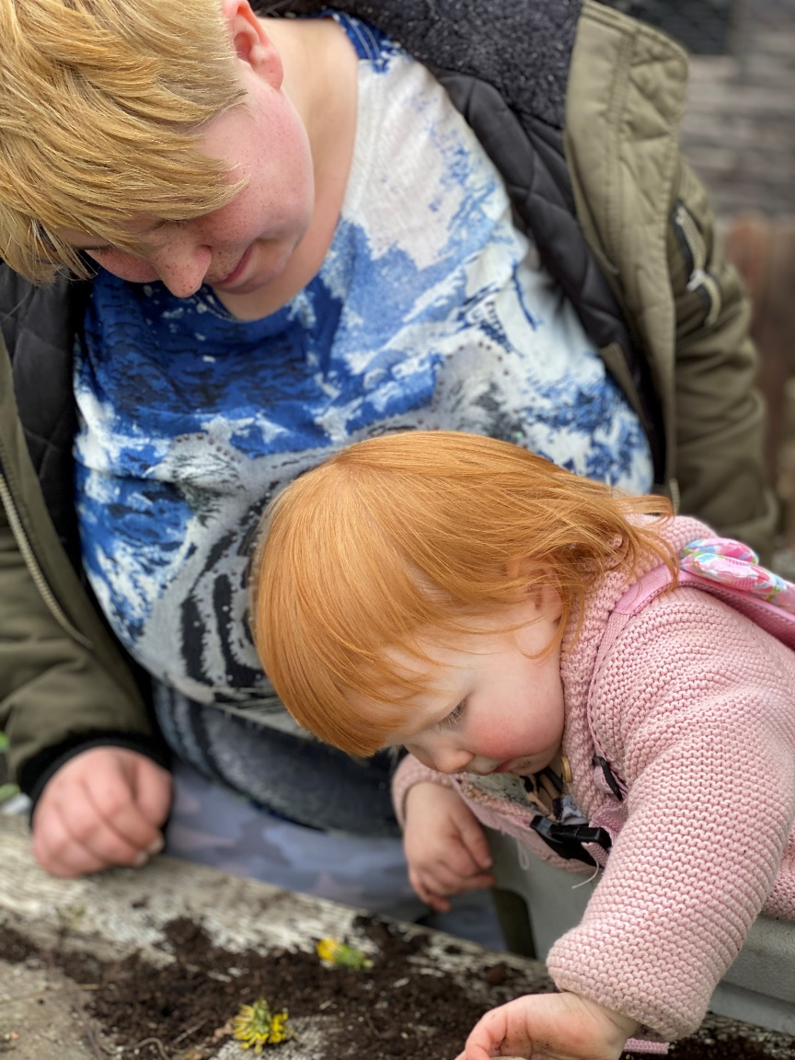
Invite everyone!

Slide 25
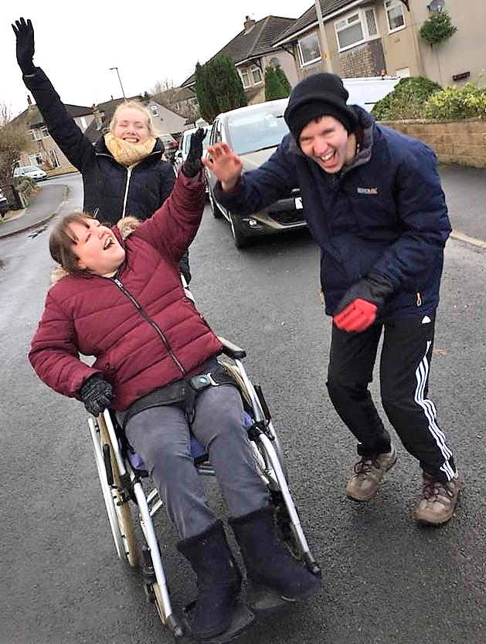
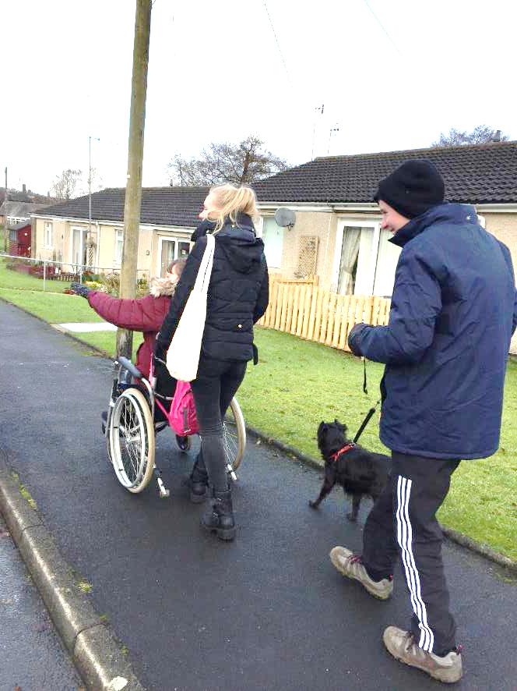
Lead good lives in the heart of
our communities!

Slide 26
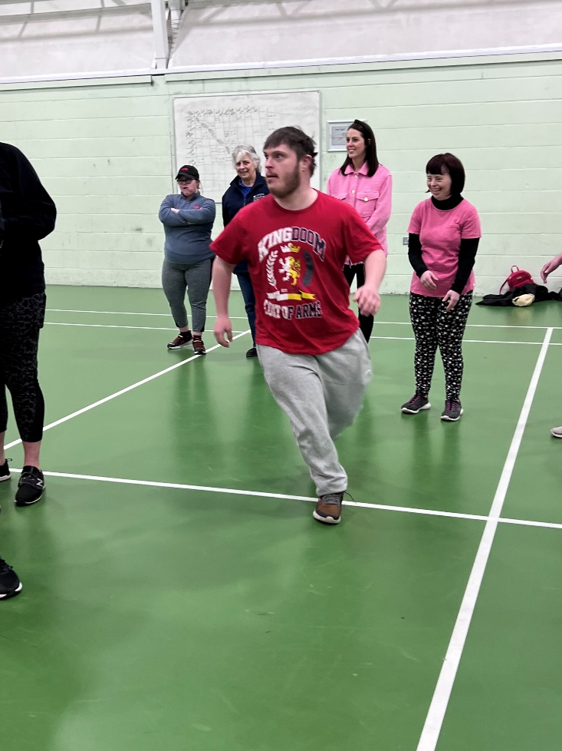
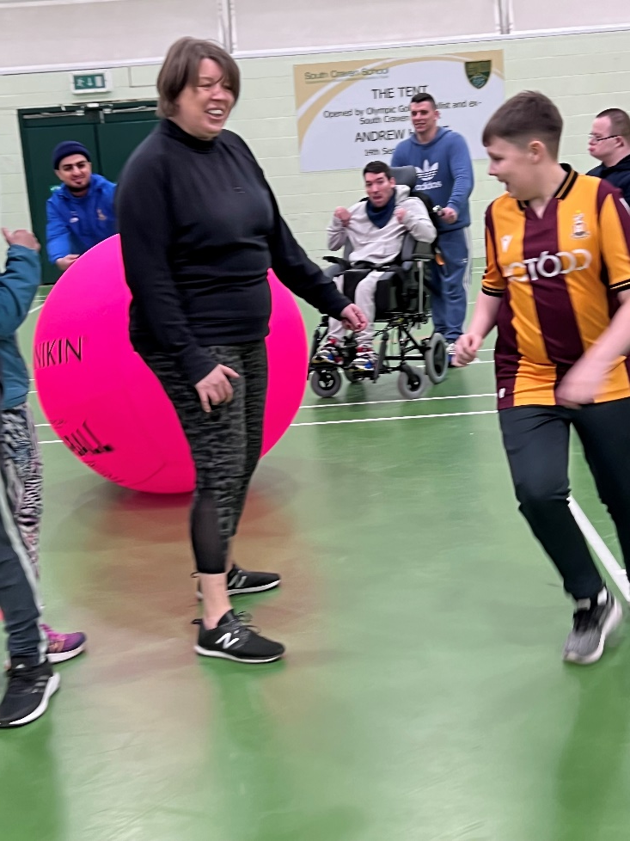
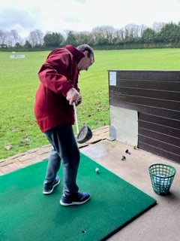
Try fun ways to keep fit

Slide 27
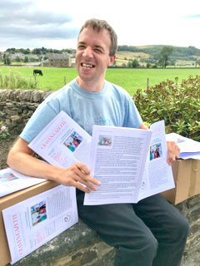
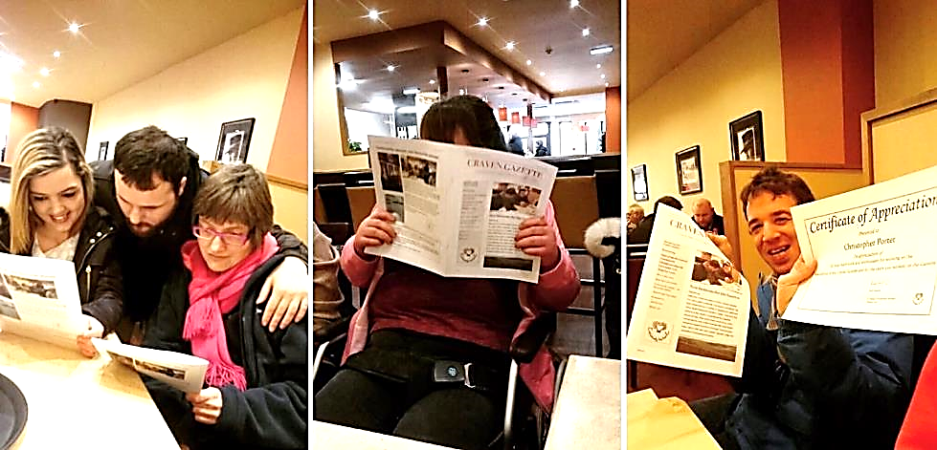
Write about our experiences and publish
our own magazine The Craven Gazette!

Slide 28
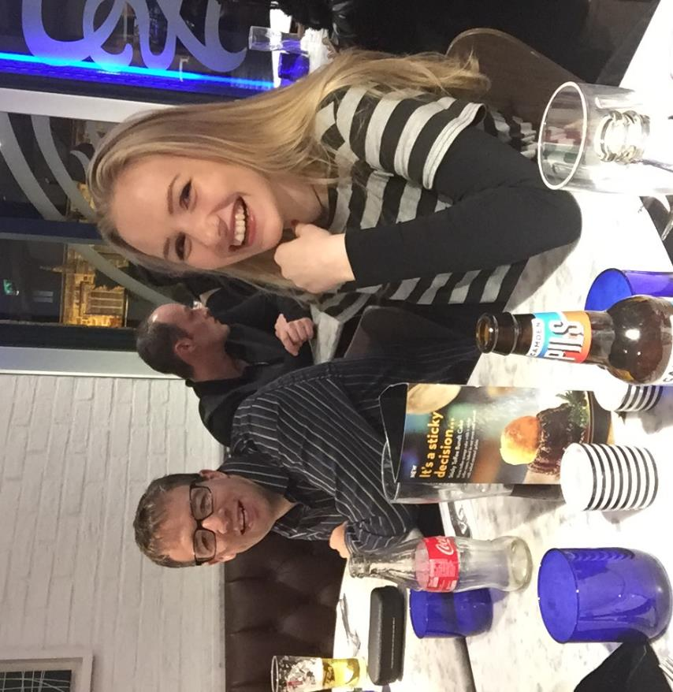
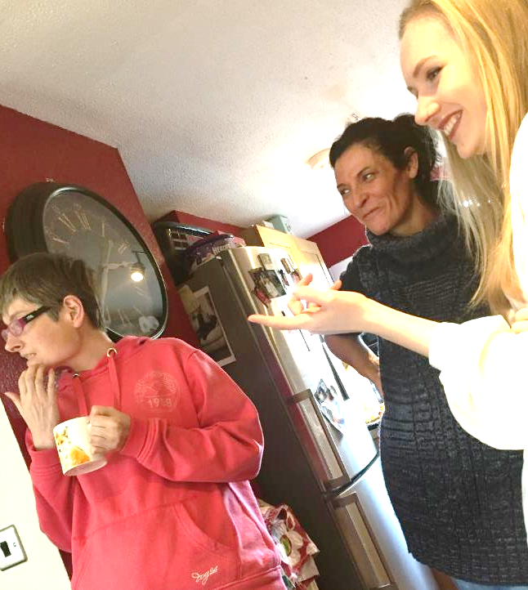
Make friends!
Go out in the evening and party!

Slide 29
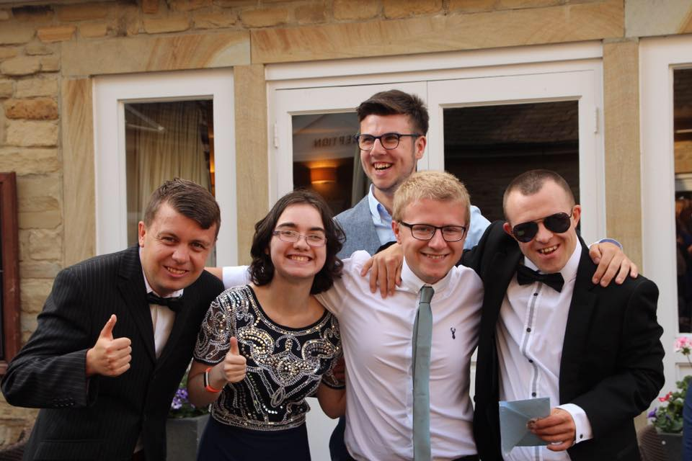
Go to the ball!

Slide 30
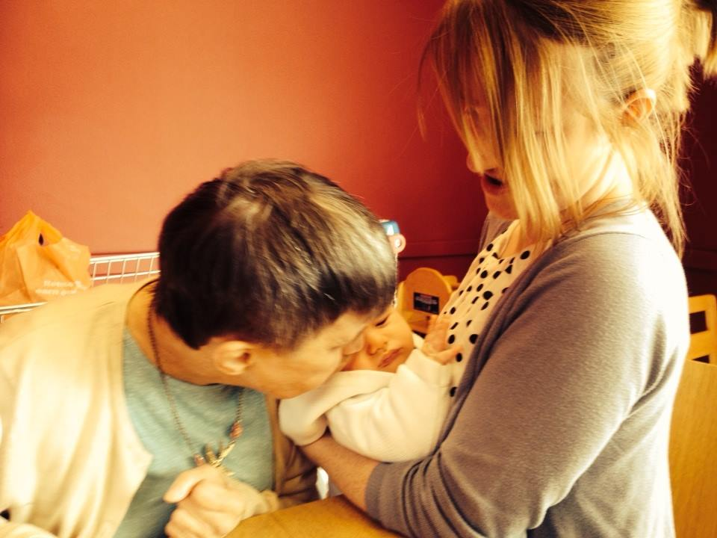
Love and be loved!

Slide 31
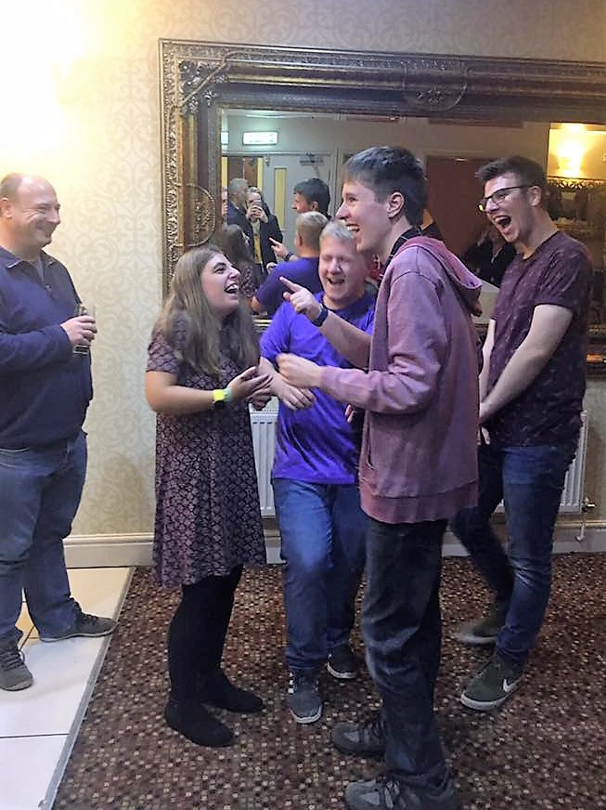
Value our history
Stay in touch with our school friends!

Slide 32
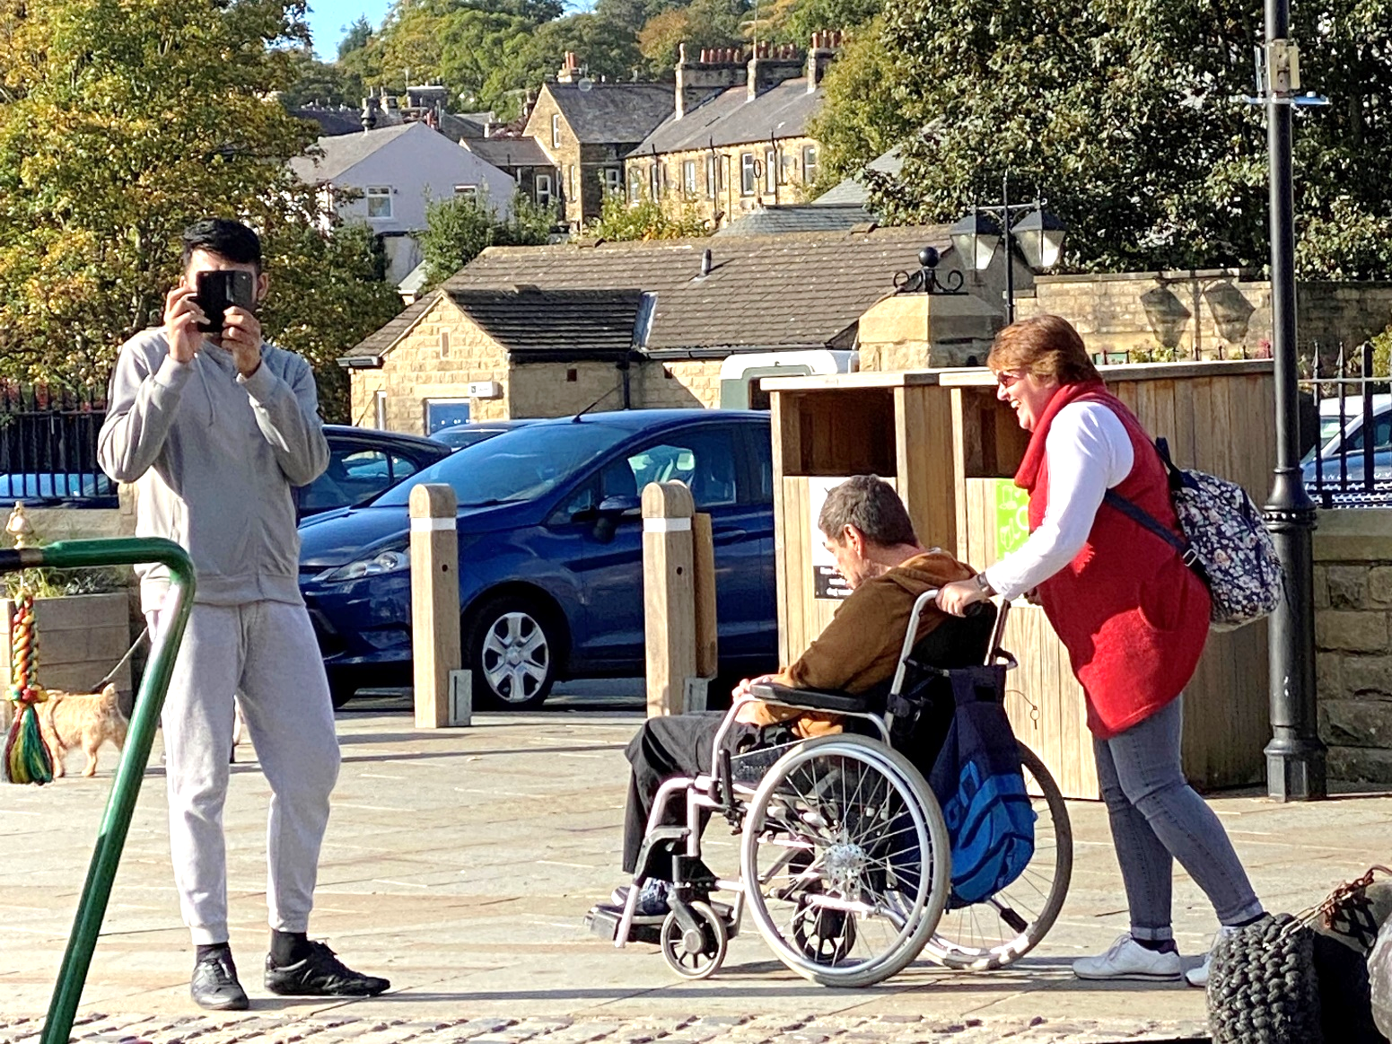
If needed bring our own support
to help us join in

Slide 33
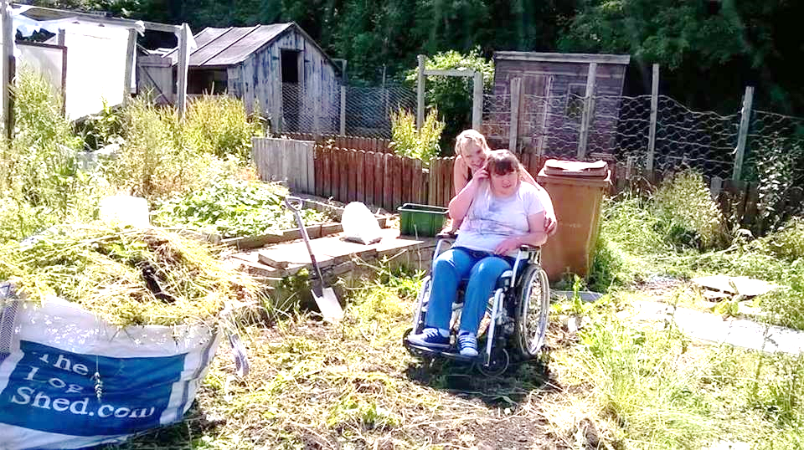
Set ourselves a challenge!
You should see it now!

Slide 34
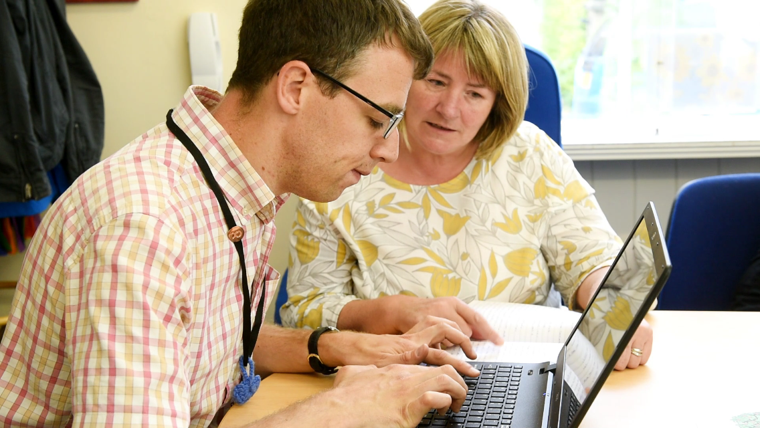
Value “interdependence”
We depend on each other!

Slide 35
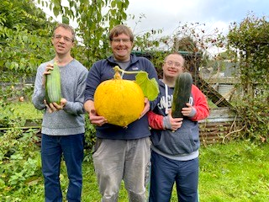
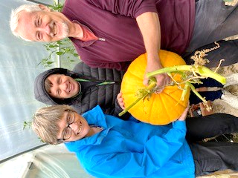
Grow together!

Slide 36
Enjoy the finer things in life with friends! Have you been to Betty’s?

Slide 37
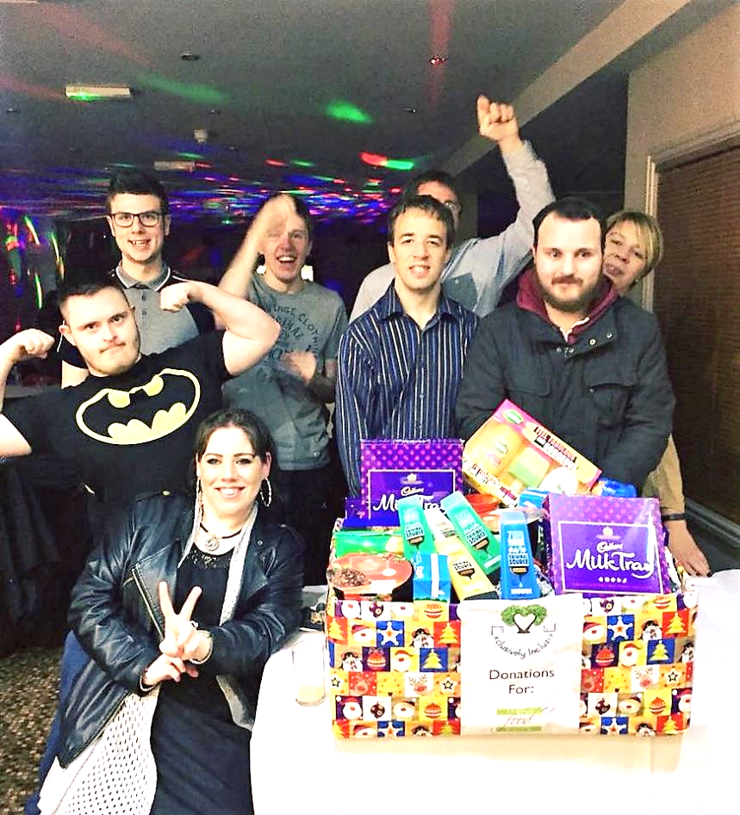
Make a difference in our communities!

Slide 38
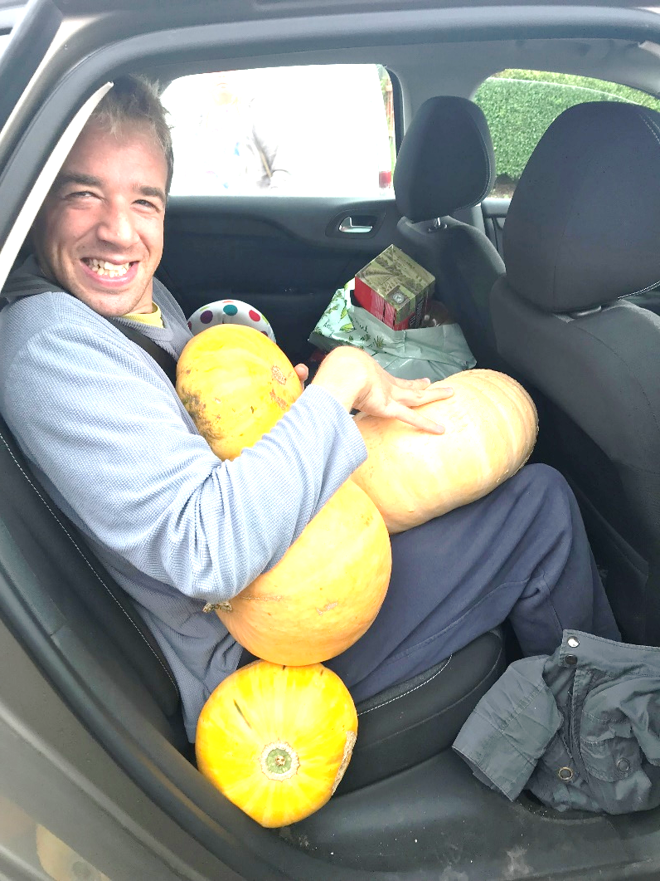
Juggle and make it happen!

Slide 39
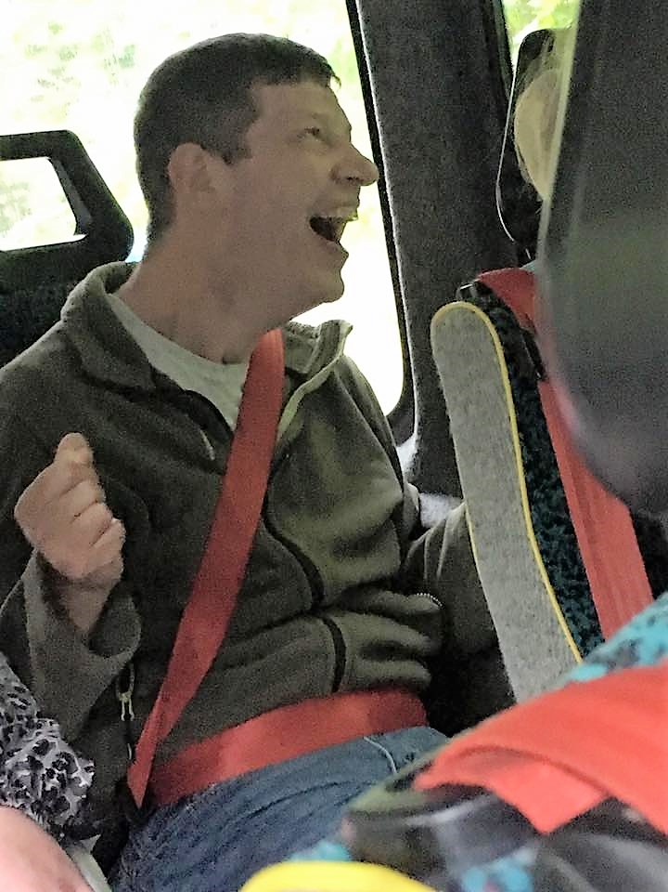
Live, Laugh, Love

Slide 40
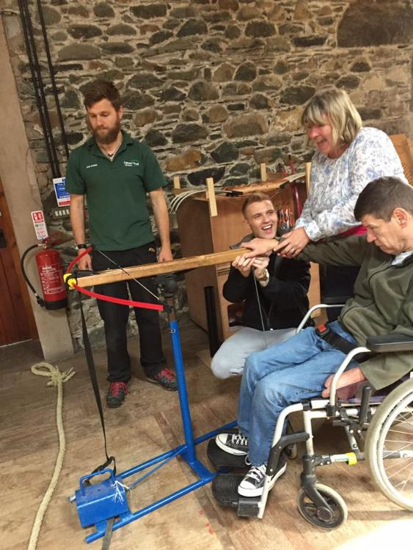
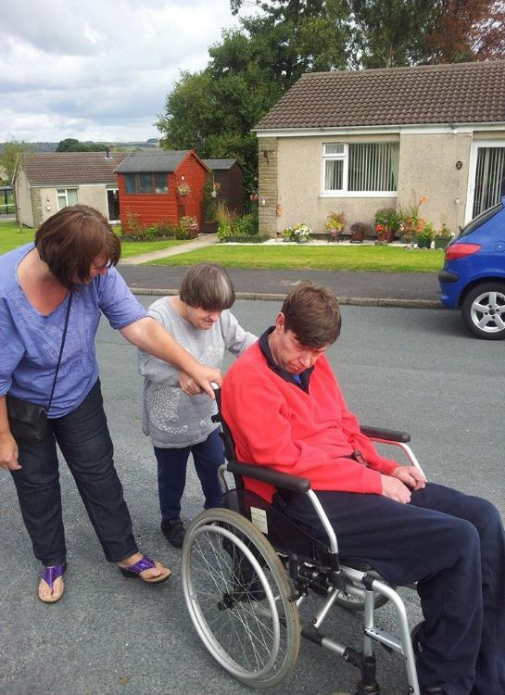
We give things a go!

Slide 41
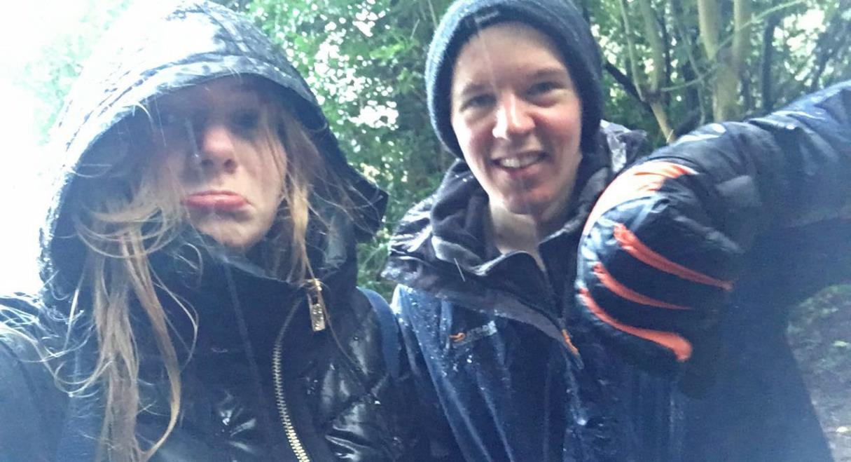
Encourage each other to keep going!

Slide 42
Invite each other to share our passions!

Slide 43
Get out and about!

Slide 44
Share our skills and our goodies!

Slide 45
Find ways to stay connected
Superstar DJ Dale kept us going during lockdown
at our front room discos over Zoom

Slide 46
Simply be together!

Slide 48
Thank you for choosing to join our workshop.
We hope you have found it useful and it helps you to build community for inclusion wherever you live.
You can find Exclusively Inclusive on social media
Facebook: @exclusivelyinclusivecraven
Twitter: @excinclusive
Instagram: @excincnorthyorkshire

