Slide 2
Making change happen for Good Lives, Action by Learning Disability England members

Slide 3
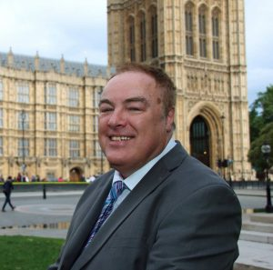
What Ive seen and heard today
Here are some of the things I thought were important or inspiring today…

Slide 4
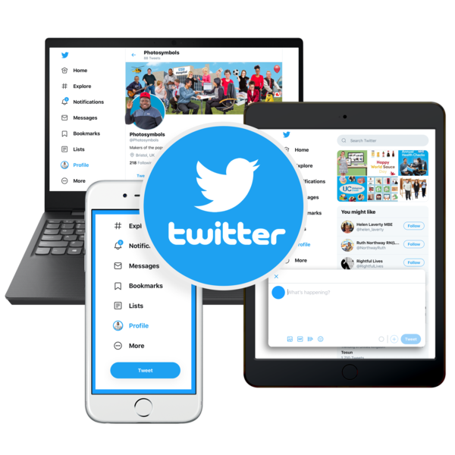
Have you shared your actions?
You can share any action you have taken towards Good Lives or that you plan to take, big or small using the hashtag...
#GoodLives
#ActionTowardsGoodLives

Slide 5
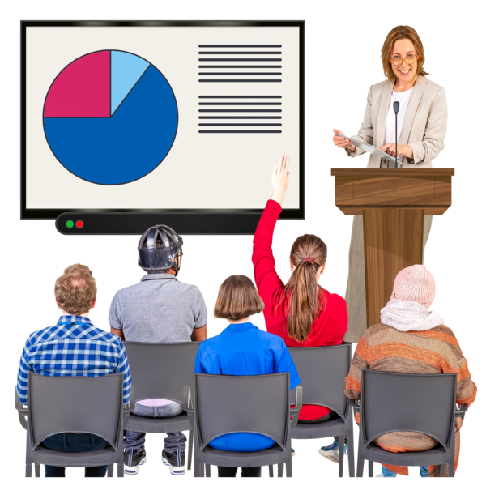
Using Good Lives
We know of over 50 events where Good Lives has been shared and we have met with 34 member organisations to share it with their teams.
The lead from Local Government Association for the Better Lives Outcomes framework shared a blog that explains how Councils can use Good Lives and the Better Lives framework.
Social Care Futures, wrote a blog about how the two movements link together
R

Slide 6
Using Good Lives: Research
The Kent, Surrey and Sussex Research network (NIHR) launched ‘Good Lives, Learning Disability Research Network’. The network is to develop research that is shaped by relationships that are built with and listen to what people with a learning disability and their networks have to say. The Good Lives symbol is on the launch material.
Some Researchers are looking at how they can share stories from their new book and a blog on how Good Lives have evolved since An Ordinary Life in 1980s
R

Slide 7
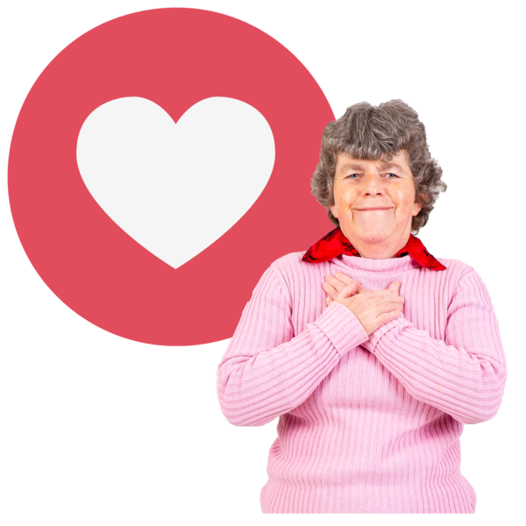
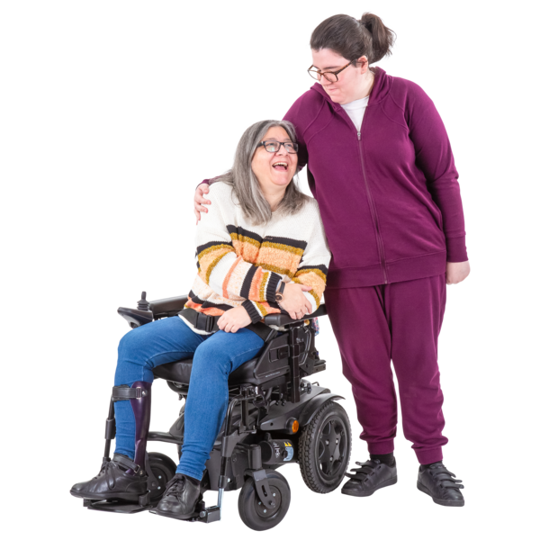
Members Actions:
The Friends and Relationships Group in Lancashire (sub group of the learning Disability Partnership Board) took each of the goals from 'to love and be loved' and thought about what they needed to do to achieve them in Lancashire. They made a report from this.
Macintyre filmed a podcast talking with Gary about Good Lives for the families they support.
G

Slide 8
Members Actions:
Learning Disability Network London Community Hub and their Our Choice Advocacy Project held a Good Lives Consultation Group looking at each chapter
Campaign 4 Change are holding ‘wheel of engagement’ podcasts – tied into the topics of Good Lives

Slide 10
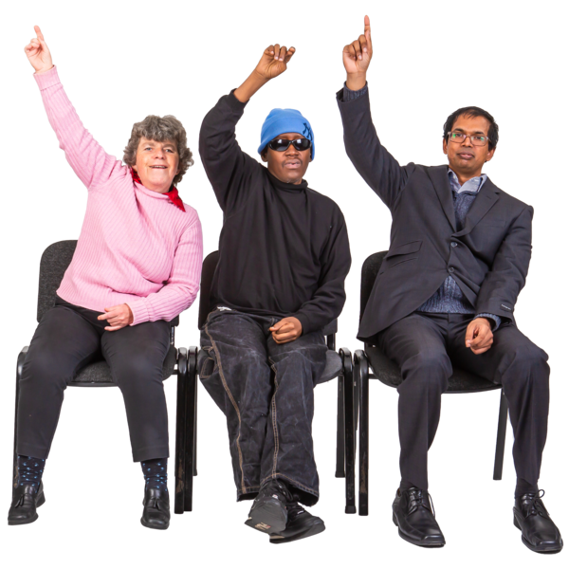
What have you done in the last year?

Slide 11
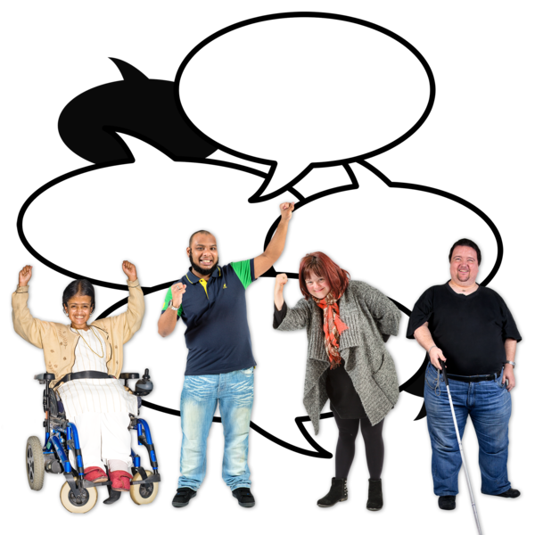
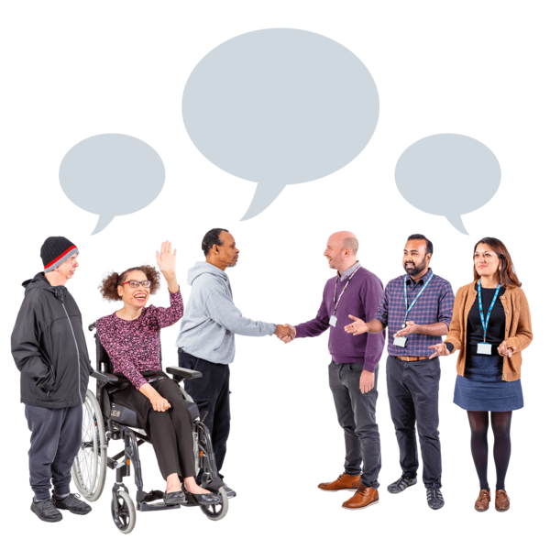
Our aims for 2023
Continue to build a movement ​
Looking to build our evidence base​
​Collect examples of action and impact ​
Demonstrate the impact we can make when we connect
G

Slide 12
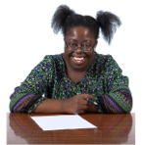
Actions​ for 2023
Create specific actions for people get involved with​
MP Letter​
Action Bank​
Feedback before we refresh
Action for Good Lives Logo
R

Slide 13
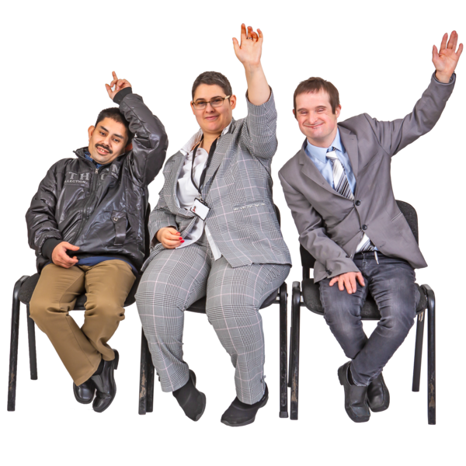
Action from today
What's inspired you today?
Is there an action you can take forward?

Slide 14
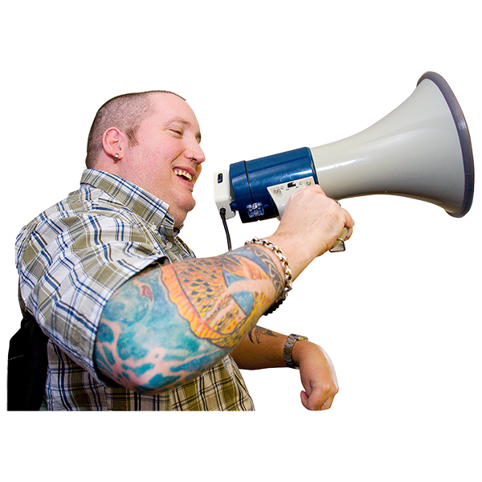
Our big messages
We want to continue building a movement for change
Good Lives to be a common cause we can all stand behind
Thank you for being part of all the work in the last year

