Slide 1
RENTING YOUR OWN PLACE RESEARCH
LEARNING DISABILITY ENGLAND CONFERENCE
TUESDAY 28TH MARCH 2023, YORK

Slide 2
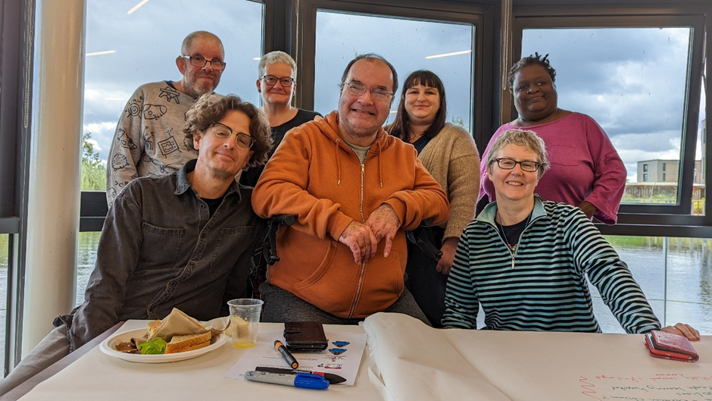
MEET OUR TEAM

Slide 3
HANDS UP:
Who has rented their own place?
Who has supported people to rent?

Slide 4
ABOUT
OUR RESEARCH

Slide 5
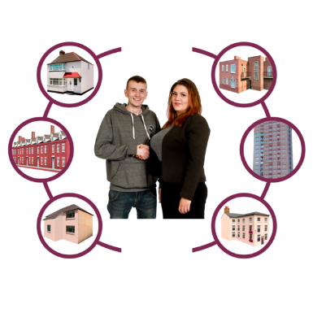
We tried to find out:
What’s going on for people with learning disabilities who rent their own home?
What support is there?
What needs to get better?

Slide 6
How did we find this out?:
We spoke to 35 people renting their own home
We asked people to complete some booklets about their homes (and take photos)
We looked at what people had said and made

Slide 7
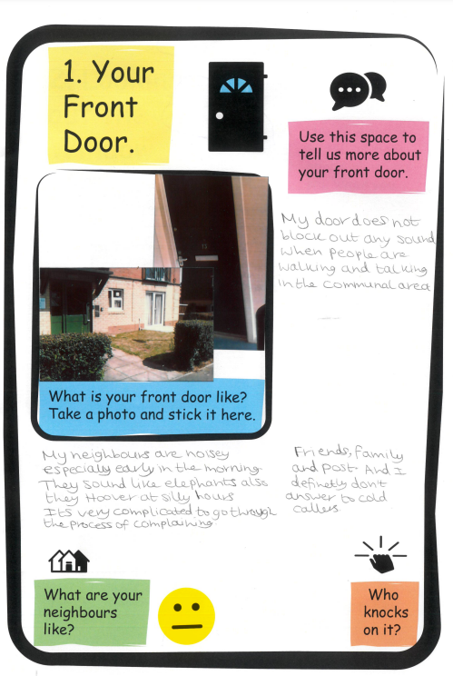
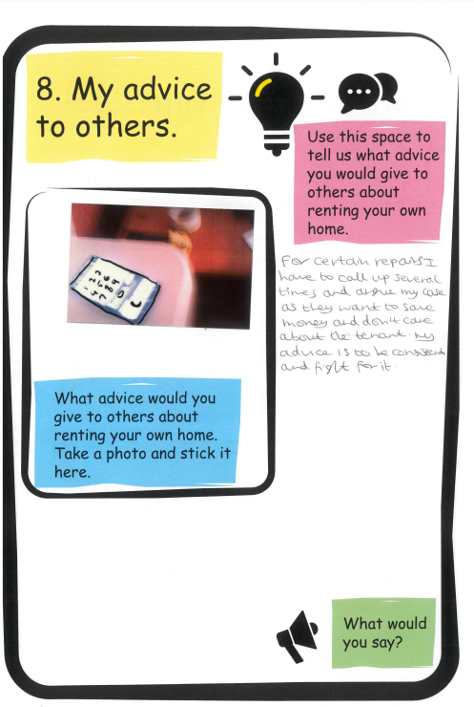

Slide 8
What did we find out?

Slide 9
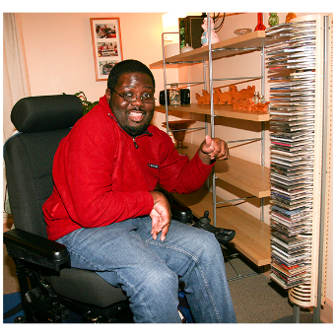
We found:
Most of the people we spoke to liked renting.
They were settled in their home, could afford their rent and were good tenants.

Slide 10
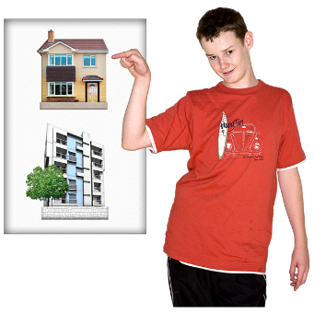
We found:
Most people did not get much choice when they moved to the place they rent.

Slide 11
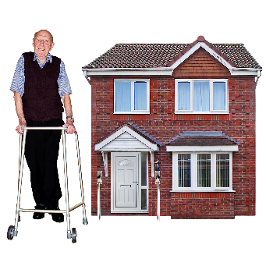
We found:
Most people lived in good quality housing
BUT
Some people needed housing to be adapted to meet their needs and some needed repairs

Slide 12
We found:
It was very important to people that their home was close to friends or family, transport and shops.
AND that it was a safe neighbourhood.

Slide 13
We found:
When people had paid support from social care it was often working well
BUT people said it could be more person centred

Slide 14
We found:
Lots of other places help with renting like self-advocacy groups and employers
Some people wanted more support

Slide 15
Any questions?

Slide 16
What would you tell a friend who wanted to rent?

Slide 17
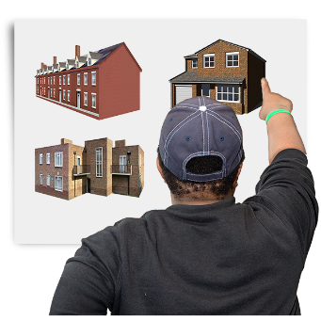
RENTING RECOMMENDATIONS
Choice
Support
Good quality housing
Good location
Affordable

Slide 18
RENTING RECOMMENDATIONS
Information
Secure
Involved
Adapted
Reasonable adjustments

Slide 19
THANK YOU FOR LISTENING

