Slide 1
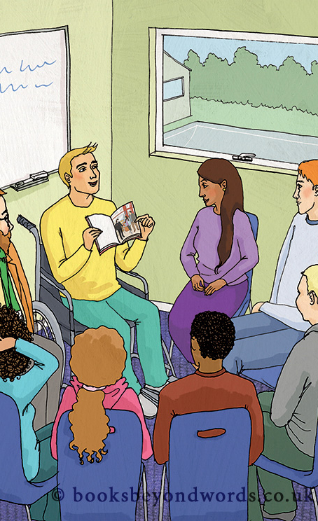
The Power of Pictures
How word-free books can help us relate to our surroundings and tell our own stories

Slide 2
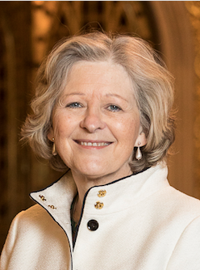
Professor Sheila the Baroness Hollins
Founder of Beyond Words

Slide 3
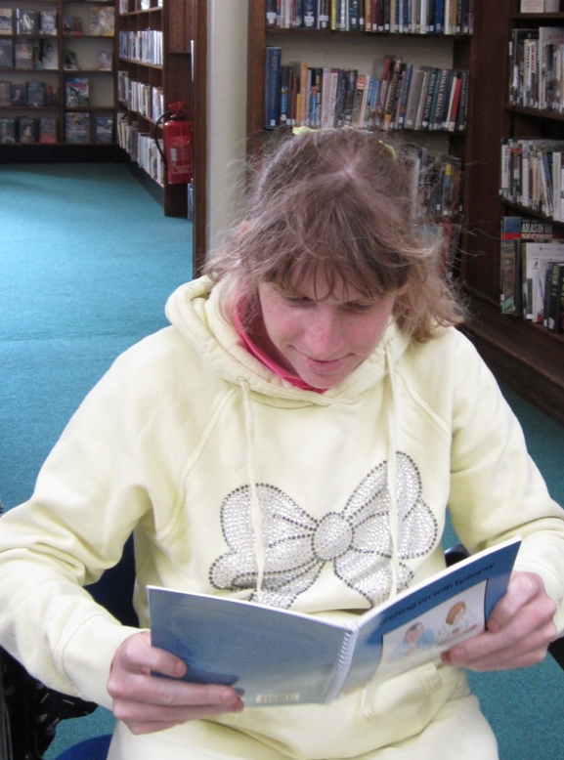
We promote visual and emotional literacy
Some people who can read a little will be able to tell and read a story more fluently through pictures

Slide 4
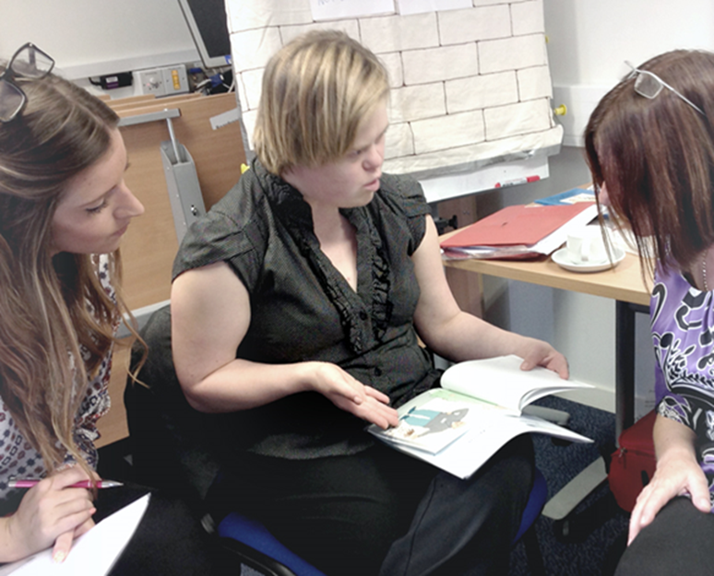
Visual Literacy is…
the ability to make meaning from a picture

Slide 5
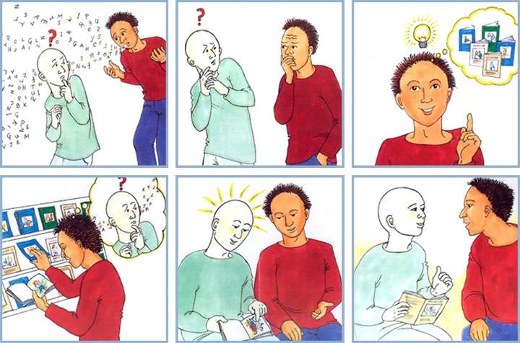
Using our books to communicate

Slide 6
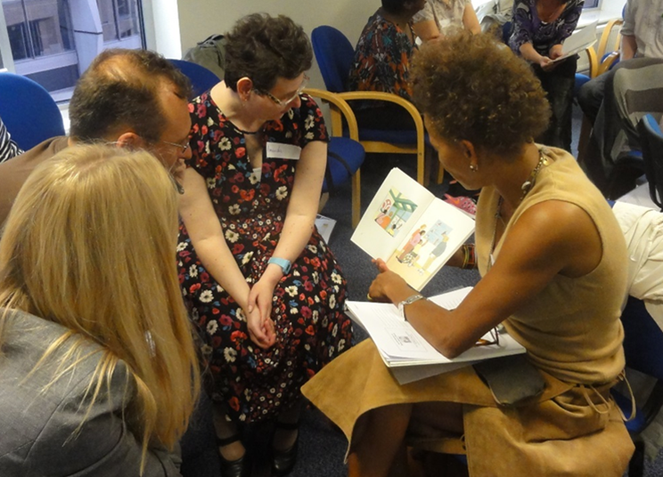
Book Clubs
A group of people who meet to read stories and have fun

Slide 7
How our live book club will work

Slide 8
Please welcome our panellists
Nigel Hollins, Founder of Beyond Words
Sue Carmichael, Beyond Words Book Club Champion
Wayne McGregor, Author and Book Club trainer
Lucy Alexander, Beyond Words Community Engagement
Emily Magdij, Beyond Words Communications Manager

Slide 9
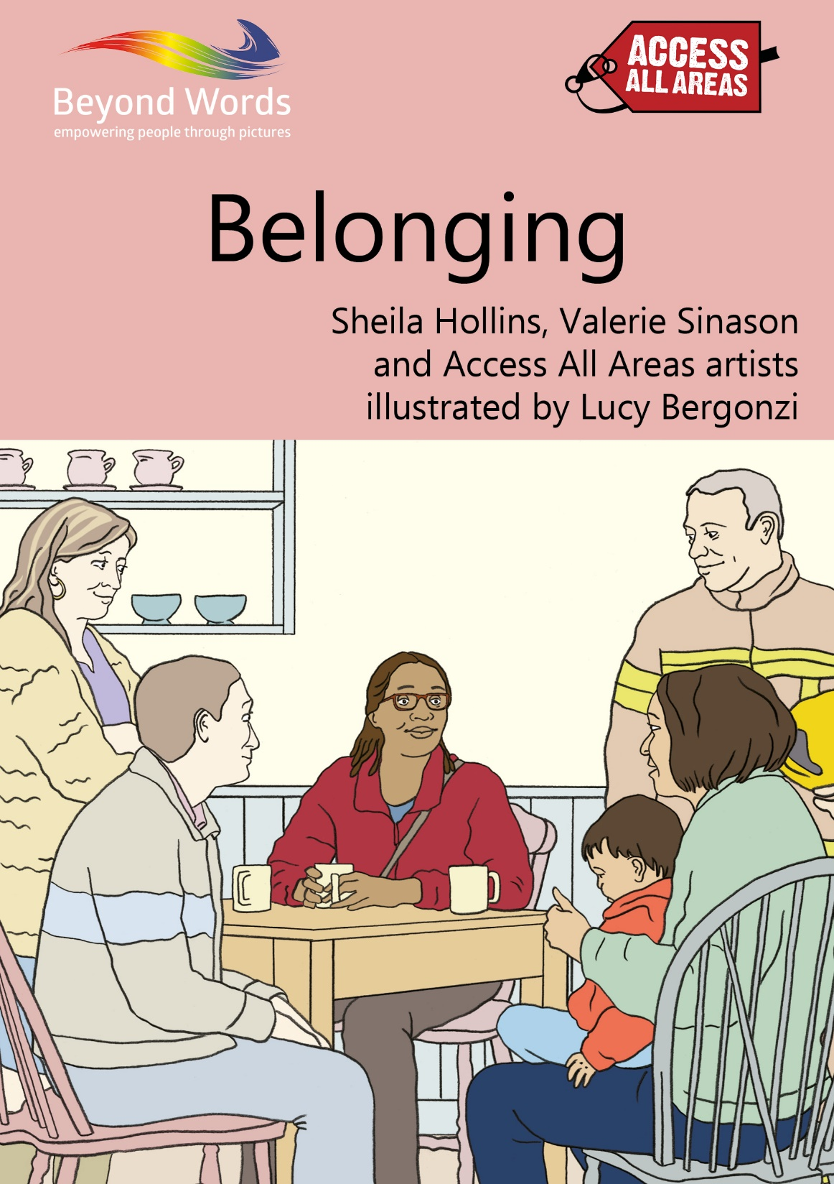

Slide 10
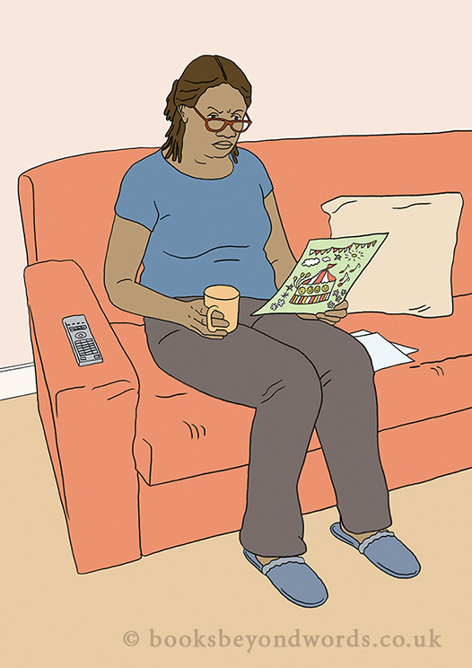

Slide 11
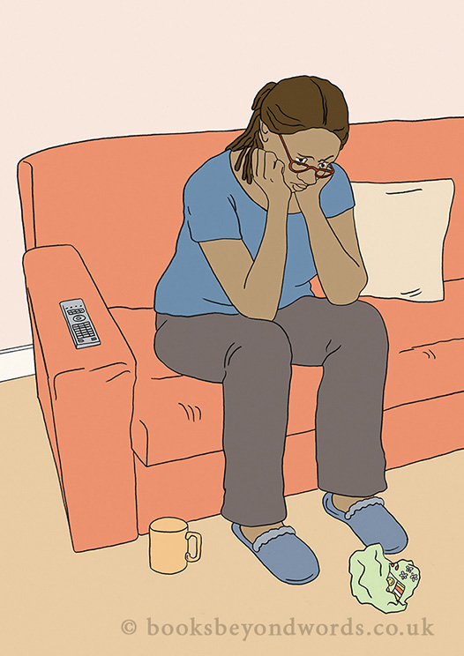

Slide 12
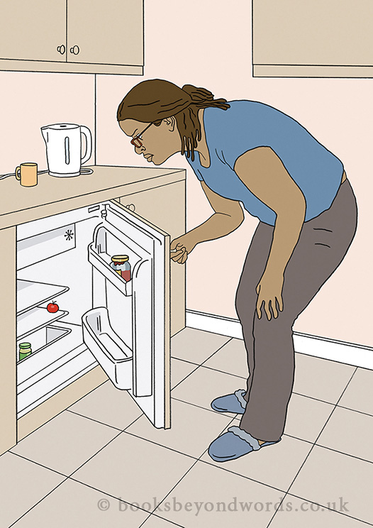

Slide 13
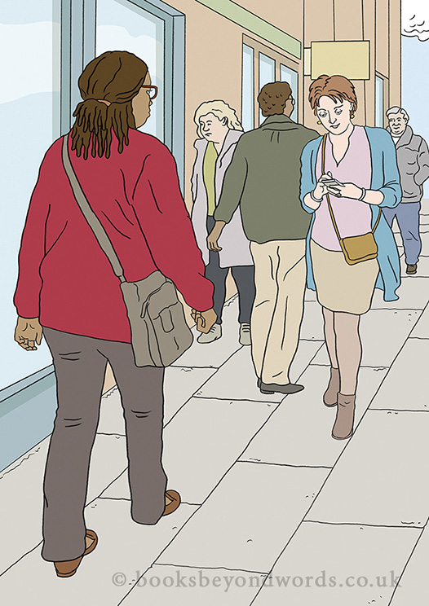

Slide 14
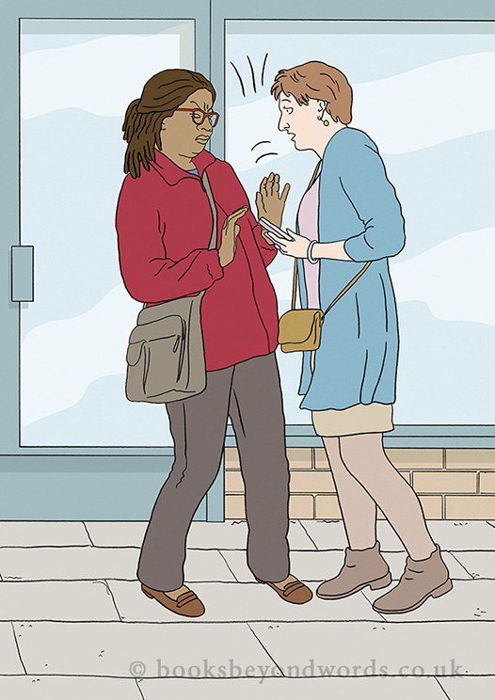

Slide 15
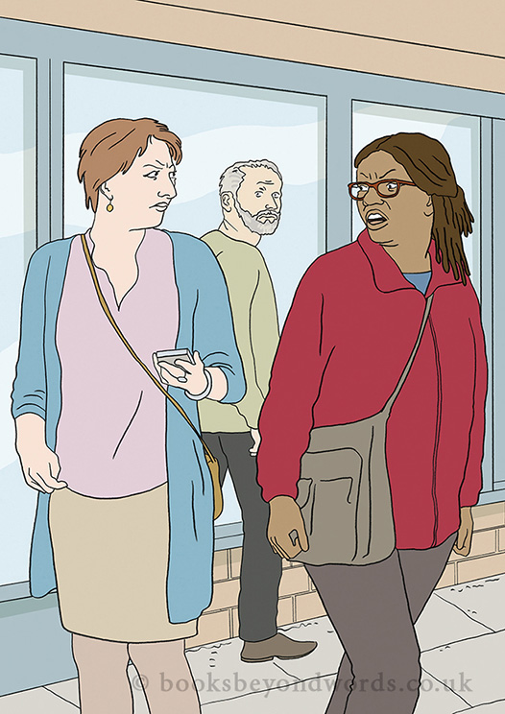

Slide 16
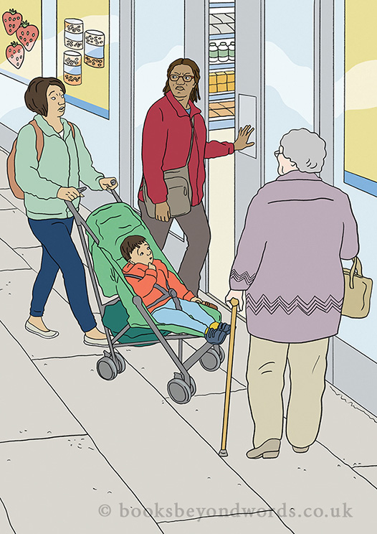

Slide 17
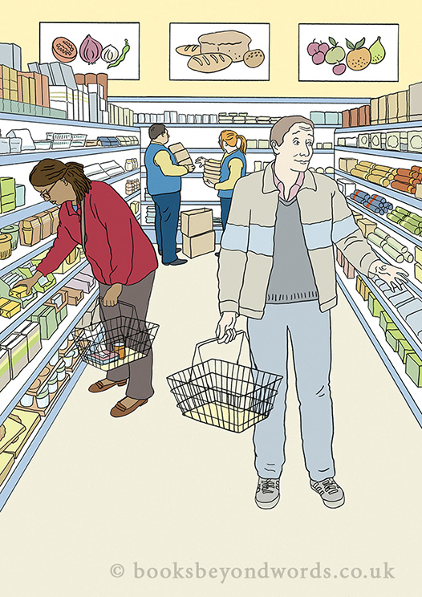

Slide 18
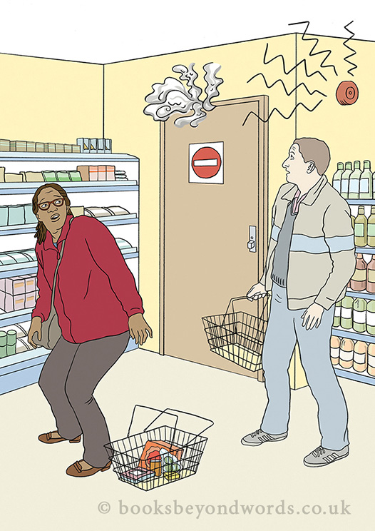

Slide 19
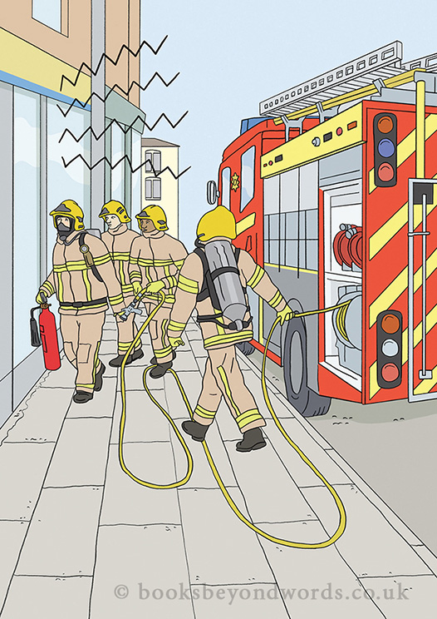

Slide 20
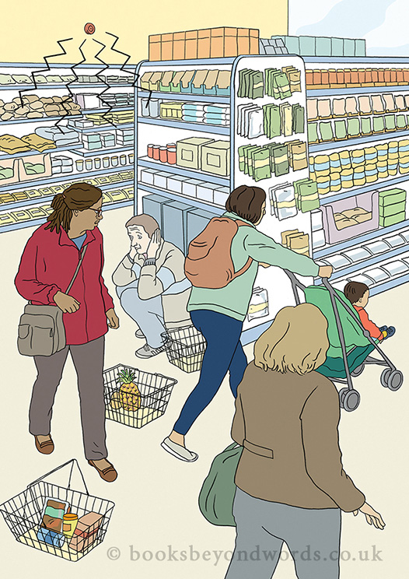

Slide 21
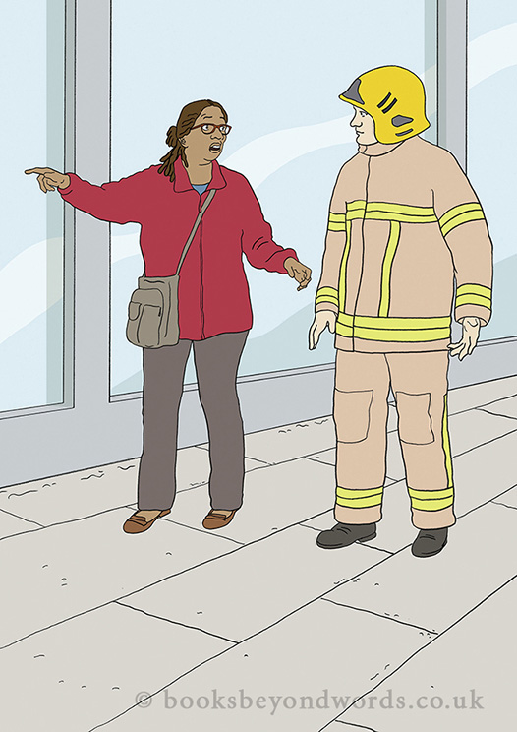

Slide 22
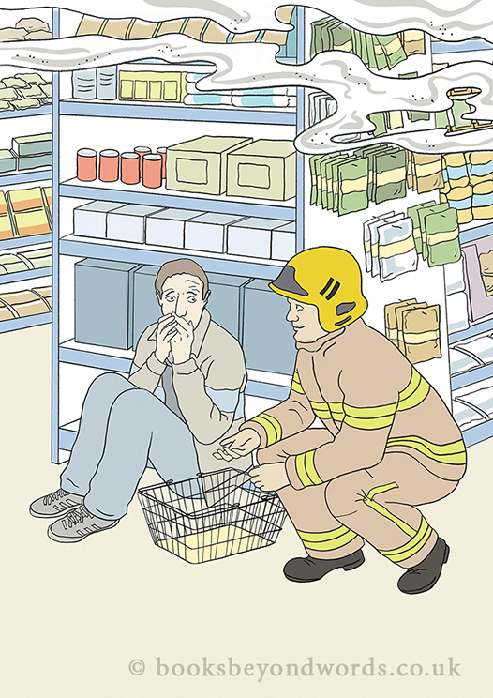

Slide 23
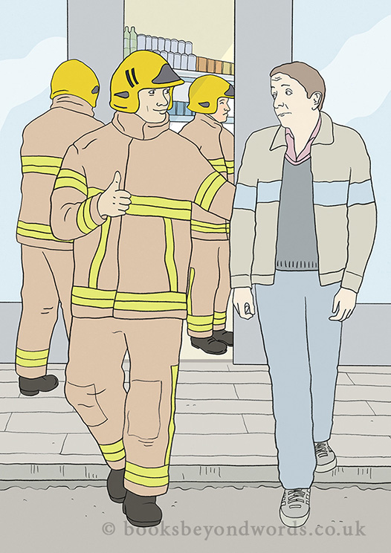

Slide 24
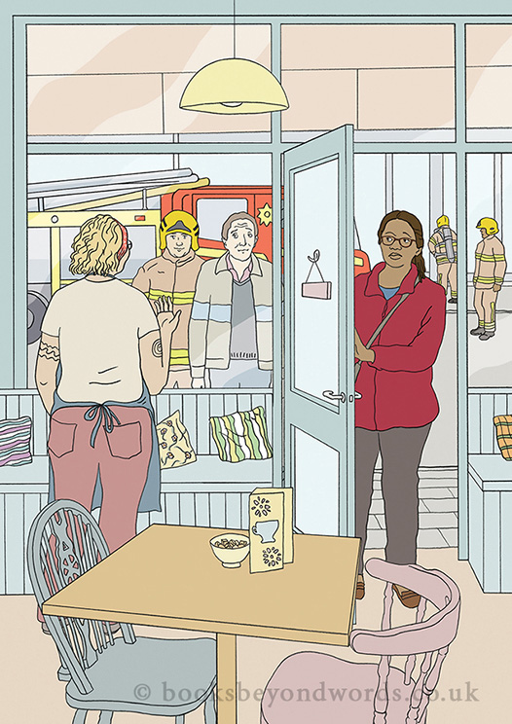

Slide 25
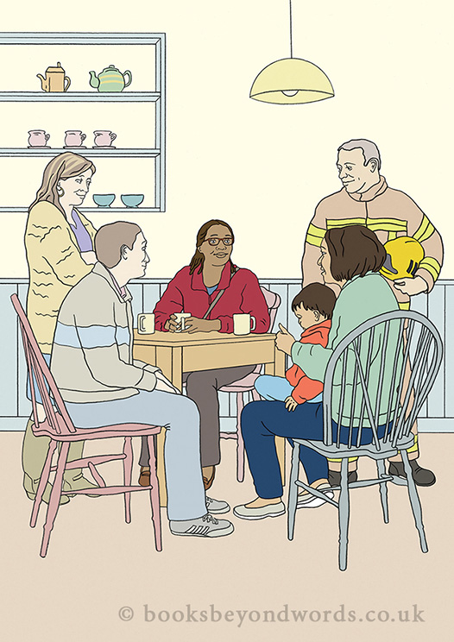

Slide 26
How do people feel about reading the book?
Did you learn something new?
How did the story make you feel?

Slide 27
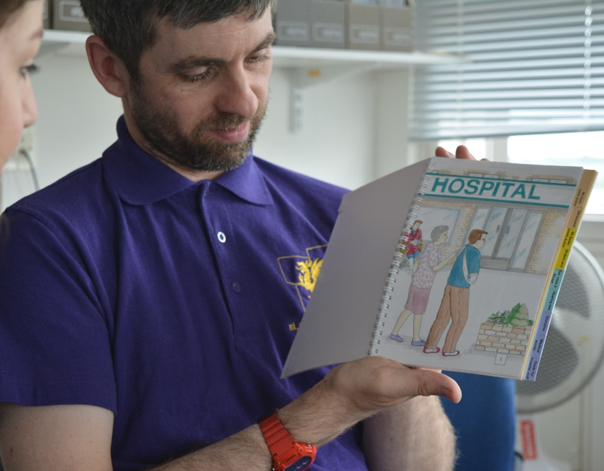
Thank you for joining us today
For more information email:
bookclubs@bookbeyondwords.co.uk

