Slide 1
Leadership training for people with learning disabilities and autistic people
Survey February - April 2023

Slide 2
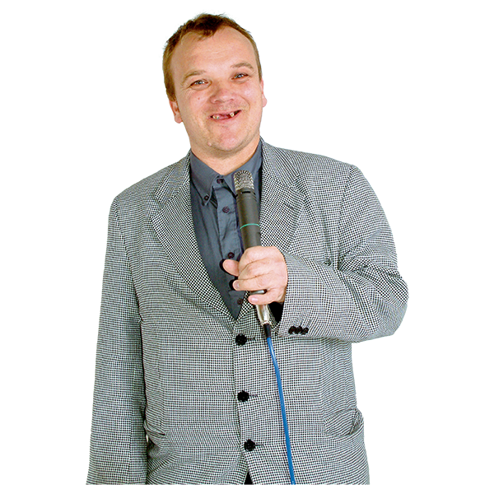
What this is about?
Leadership training for people with learning disabilities and autistic people
Learning Disability England heard there is not a lot of leadership training that includes minority ethnic people with learning disabilities and autistic people.
We were told training about different experiences and anti-racist practices is not accessible to many autistic people and people with learning disabilities.
To find out more Learning Disability England is working with Changing our Lives on this small project.

Slide 3
What this is about?
Leadership training for people with learning disabilities and autistic people
Working alongside people with lived experience to find out what leadership opportunities exist, if people from minority ethnic communities are included and what leadership opportunities should look like.
Coproducing with people with lived experience what training or leadership opportunities are needed for people with learning disabilities and autistic people from minority ethnic communities to be leaders.
NHS England is supporting the project.

Slide 4
What we are doing
For this project we are doing 3 main things:
Find out what training there is now through a survey
Meeting with some people who lead training and leadership opportunities or who have taken part to talk about what they think is good or can be better
Talk with some people from minority ethnic communities who have not been a part of these types or programmes

Slide 5
What we are doing
At the end we will write a short report that includes:
• What we found out about the opportunities now and the gaps or problems
• What is needed to support leadership by minority ethnic people with learning disabilities and autistic people

Slide 6
What we heard from the survey
These slides are about the survey we ran.
Shared 23rd February – 24th April 2023
It was hosted as a news piece on Learning Disability England’s website.
Learning Disability England promoted it in the members newsletter, social media and direct e mails to members or partners.
NHS England promoted the call through the programme newsletter and social media.

Slide 7
Who replied
There were 4 complete responses and 1 incomplete response

Slide 8
Who replied
There were 5 responses – 4 complete and 1 incomplete
ANSWER CHOICES | RESPONSES
Someone who is leading leadership training or has led it in the past | 20.0% | 1
An organisation that designs and leads leadership training or has in the past | 80.0% | 4
Someone who has been part of a leadership course as a learner | 0% | 0
Other (please specify) | 0% | 0
TOTAL |  | 5

Slide 9
4 people were sharing information about 1 course
1 person gave information about 2 courses

Slide 10
Who the training course or programme is aimed at

Slide 11
When the course or programme was last run

Slide 12
Has the course or programme been formally evaluated?
1 programme is being evaluated now

Slide 13
The programmes include these issues

Slide 14
What else is included in the programme or training?
Co-production and citizenship
Governance
Health, Education, Social Care, Employment, Education
Governance
History of the independent living movement, parents movement and civil rights movement
Understanding the law
Person centred planning
Practice of being in control, self-directing support via personal budgets/ health budgets & direct payments
Workforce issues for those employing PAs
Specific subjects such as postural care, neurodiversity and community inclusion.

Slide 15
How the course was made accessible or inclusive
Easy read information
BSL interpreter
Worked to people’s individual needs and requirements (cultural etc.)
Wheelchair accessible venues
Easy Read website with accessible options to apply for a place
Relaxed meeting space with sofas
People who are already trustees join to support the course and speak to people
Working out what adjustments to make to ensure people can participate easily.
Online we did pre-sessions, handouts in easy read, support to aid communication and support in groupwork.

Slide 16
Specific action to make the programme accessible to people from minority ethnic communities
It was targeted only to people from these communities
No specific action
Easy read and plain English supports people with ESOL needs.
Relatable case study examples, dietary adjustments, break time adjustments

Slide 17
What respondents said will increase representation of minority ethnic disabled people in leadership roles
Education around racism and anti-racist practice of people in these roles
Targets and pledges made by organisations providing these roles.
Specific and targeted sustainable opportunities for people.
Sharing of successes of people in these roles.
Targeted outreach for training opportunities.
Seeing people others in decision making roles.
Being an inclusive provider, thinking differently about inclusion and making meaningful connections
Local intervention, engaging in local communities and investing directly in people

Slide 18
What people said was most important about the course or how it is delivered?
Was targeted and people had mentoring opportunities from others
Co-led by leaders with learning disabilities who are role-models with lived experience.
Face to face, not online.
Visiting guest experts.
Easy to understand on inaccessible subject.
Delivered in a calm and relaxing manner.
People have a good mix of inspiration and information.
Gain confidence throughout course to take a lead in their own life and/or for loved ones.

Slide 19
What respondents said could have made the programme better
More time to recruit mentors.
More EDI information in there.
Small local courses are better as adjustments made are much more fruitful in instigating change.

