Slide 1
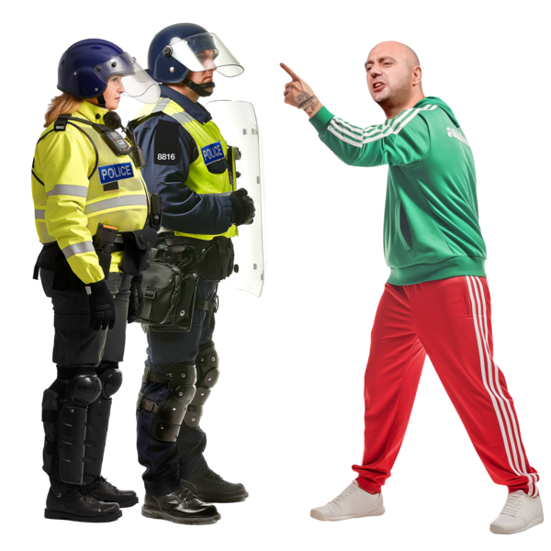


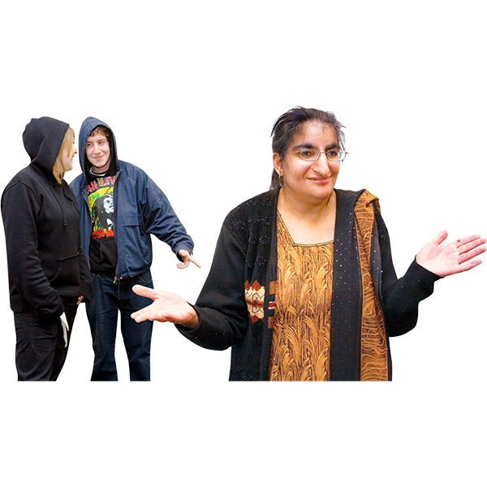


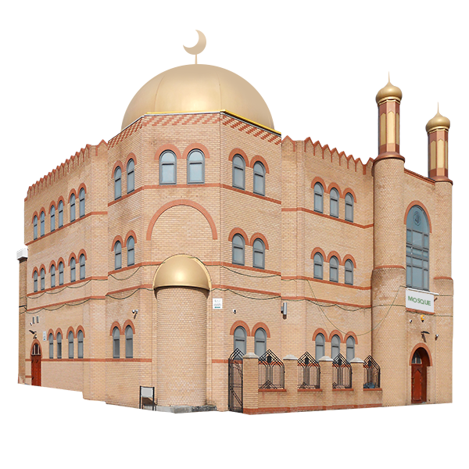


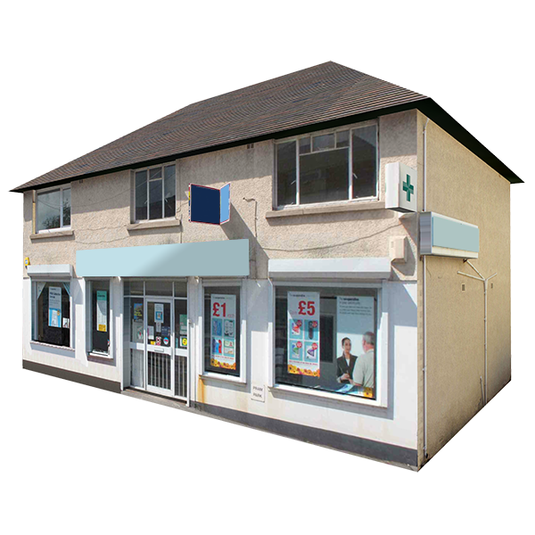
Staying safe during riots
There are riots happening in lots of areas of the UK.
The rioters are people who think the UK has too many immigrants moving to the UK
The rioters are racist, and hate people because of the colour of their skin and where they come from.
They started rioting after the murders of 3 girls in Southport.
The riots are targeting
Immigration centres
Mosques
Refugee services
People’s homes and businesses

Slide 2
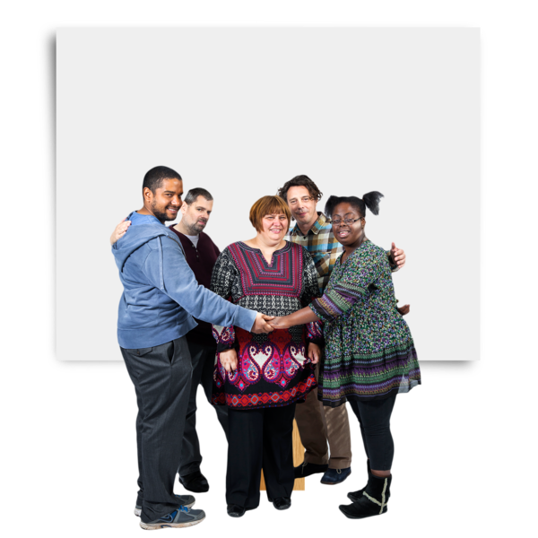

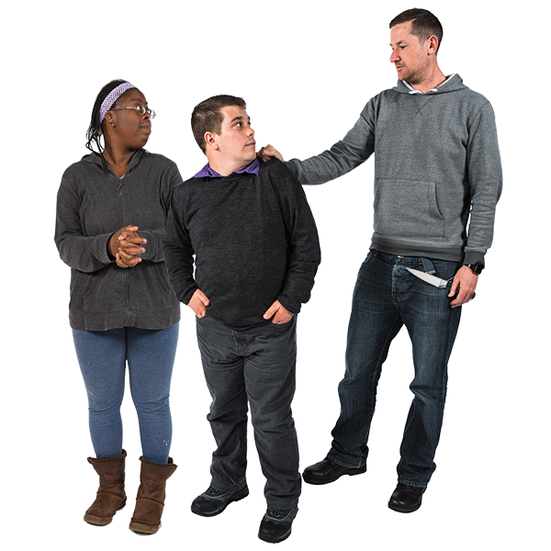
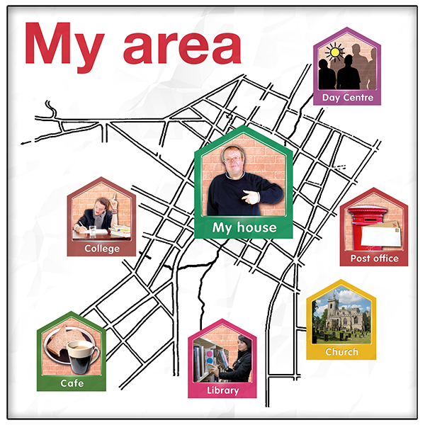




You have the right to be in and feel safe in your community.
You have the right to do your usual daily activities.
Nobody has the right to treat you badly because of who you are or who they think you are.
Things you can do to stay safe:
Find out about any riots in your local area.
Check the Hope Not Hate website for updates on planned riots
Check your local news
Ask people you trust in your community

Slide 3

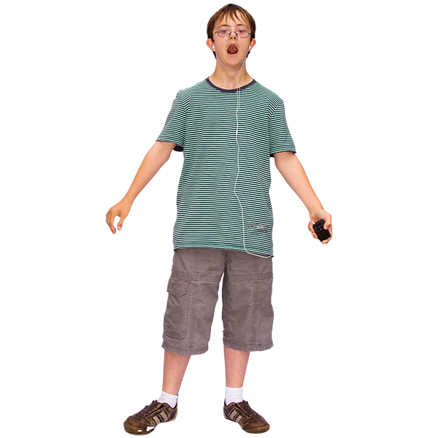
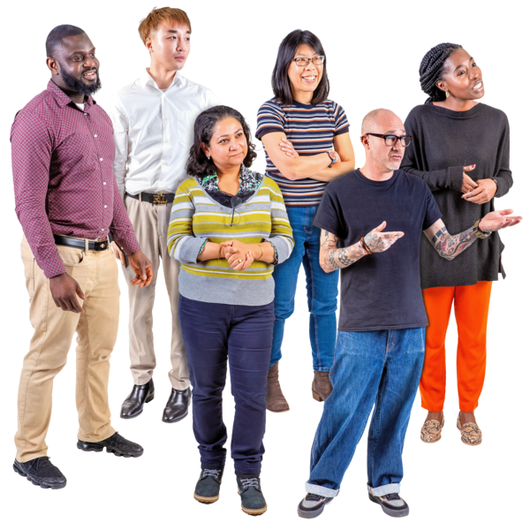
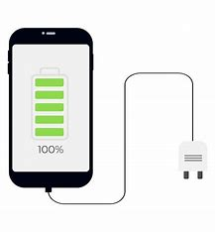
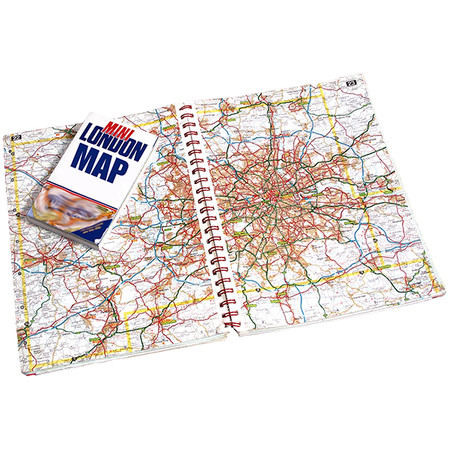

If there are riots in your area:
Stay away from the city centre
Try not to go out alone
But, try not to gather in a big group
Make sure your phone is charged
Tell someone where you are going, and what time you will be back

Slide 4

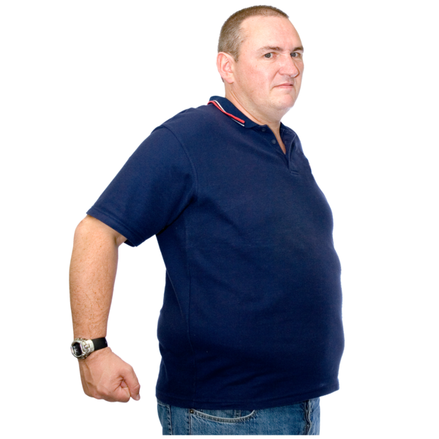
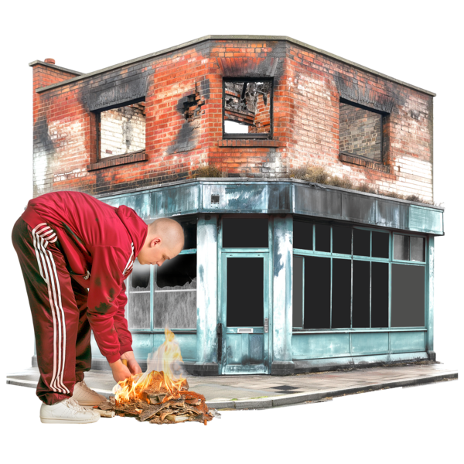



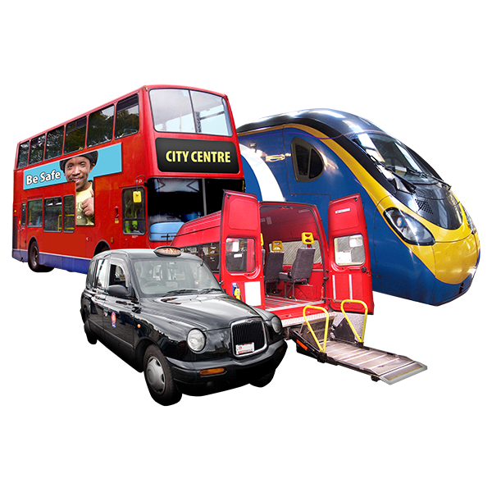
How to spot riots:
People might be in large crowds
People might be aggressive and loud
People might be damaging buildings
There might be lots of police
If you see a riot:
Don’t go near the crowd
Go somewhere you feel safe
As you are leaving, keep to streets where people will see you
Use busy public transport or a taxi if you can

Slide 5
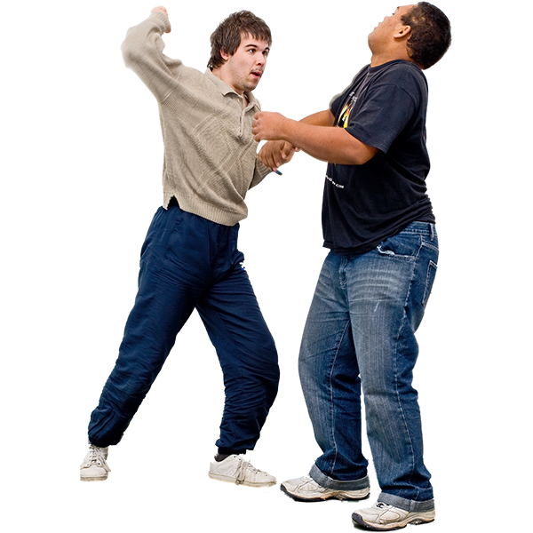
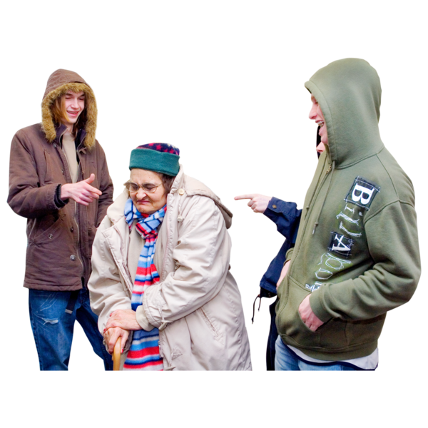

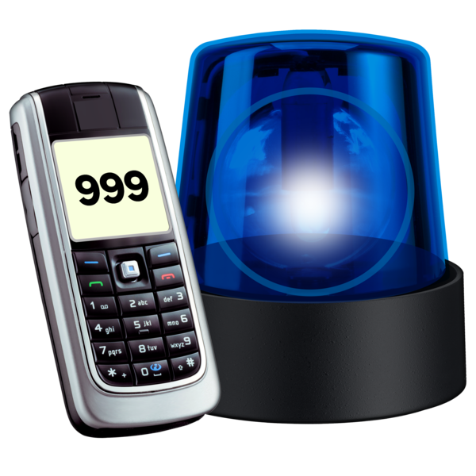
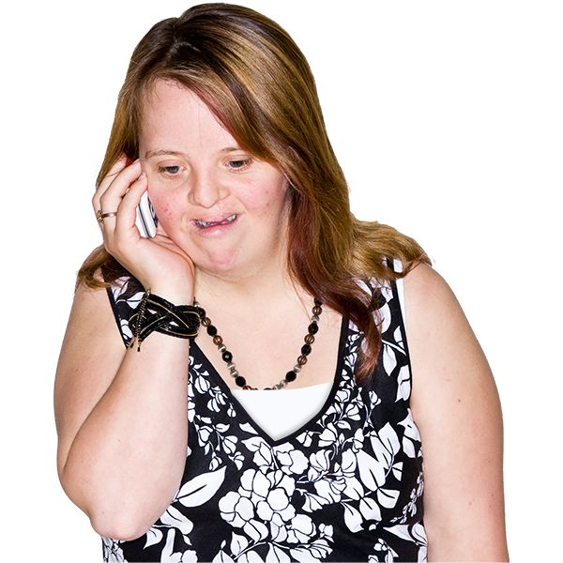


What could happen:
Some of the rioters want to:
Hurt people
Call people names
Make people feel unsafe
Damage people’s homes or buildings they use, like mosques
If this happens to you, or if you see it happen:
Call 999 if you are worried about you or someone else being seriously hurt
Report what happened
Over the phone by calling 101
Online at www.report-it.org.uk
In person at your local police station

Slide 6
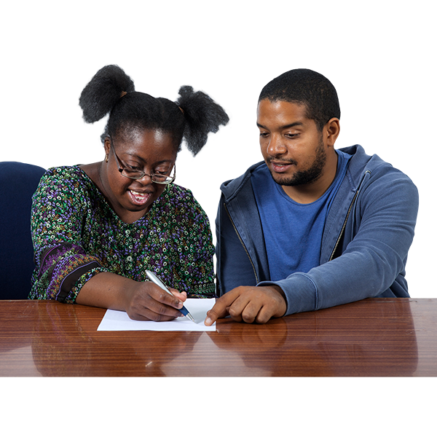
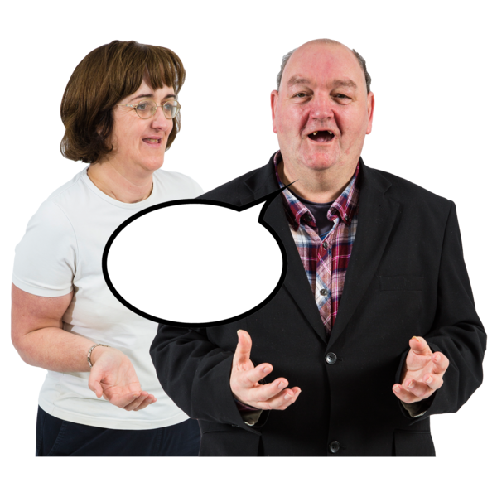
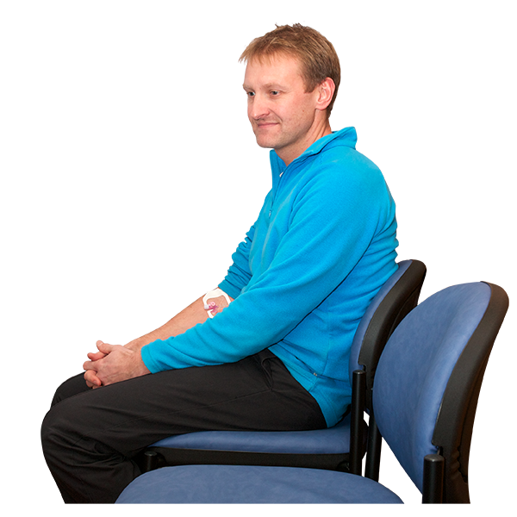
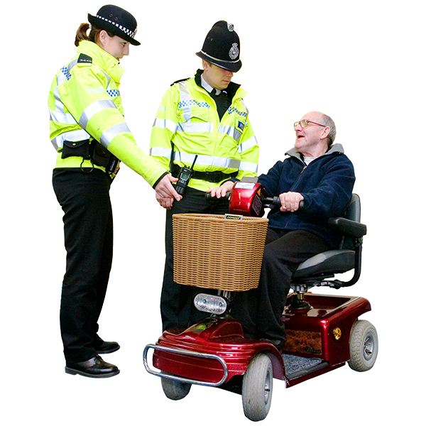
You can tell the police officer you have a learning disability, and what support you might need.
You are allowed to have someone with you when you report crimes.
The police are very busy right now, so you might need to wait longer than usual
but you have a right to report a crime and they should give you time to do this.

